Slide 1
Children’s Data Network: The Proposed development of a Statewide integrated data repository
Presented to the Child Welfare Council Data Linkages Committee
3/6/2013

Slide 2
a “snapshot” of Children
before
CPS Data
after
Children not Reported for Maltreatment

Slide 3
expanded Understanding…
child protective service records
Other Data Sources?
birth data
death data
before
CPS Data
after
Children not Reported for Maltreatment
population-based information

Slide 4
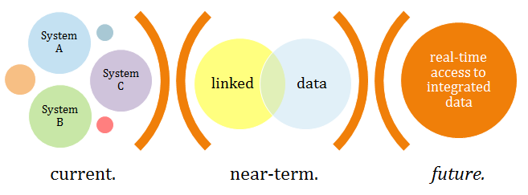
An Integrated Data repository
“Each person in the world creates a Book of Life. This Book starts with birth and ends with death. Its pages are made up of the records of the principal events in life. Record linkage is the name given to the process of assembling the pages of this Book…” (Dunn, 1946)

Slide 5
Need
Each year, government, foundations, and private agencies across Los Angeles County and throughout California invest significant resources in programs serving the 0-5 population, including the collection of data.
Although each agency serving children and families collects a tremendous amount of valuable administrative client and case data, there is no formal platform for integration and sharing.
Additionally, with shrinking budgets, agencies generally have limited resources and capacity for data analysis and thus are more likely to focus on required reporting rather than “mining” information that may be useful for program, policy and research purposes.

Slide 6
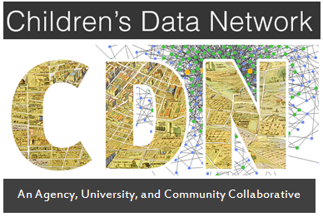
background
Mission: Leverage data to improve outcomes for young children and their families through increased access to timely, accurate, and actionable information
Notes:
* In October of 2010, the First 5 LA Board approved a motion to create a countywide “data partnership” focused on increasing access to timely and accurate information to assist in improving outcomes for families with young children. The goal was to build on existing data capacity, generating timely information and research that would directly impact policies critical to the 0-5 population and their families.

Slide 7
Four Objectives
**NEW** The development of an integrated data repository of children’s health, safety, and service records in collaboration with the UC Berkeley Child Welfare Indicators Project;
The establishment of a formal network of agency, university, and community partners invested in data-driven policy and practice as it relates to young children and their families;
The engagement of communities and policy-makers in framing key questions and developing innovative solutions to increase access to timely, publicly available data and information; and
The generation of applied and actionable research through seeded collaborative agency-university-community research projects.

Slide 8
An Integrated Data repository
University Partners
Government
Ongoing Collaboration

Slide 9
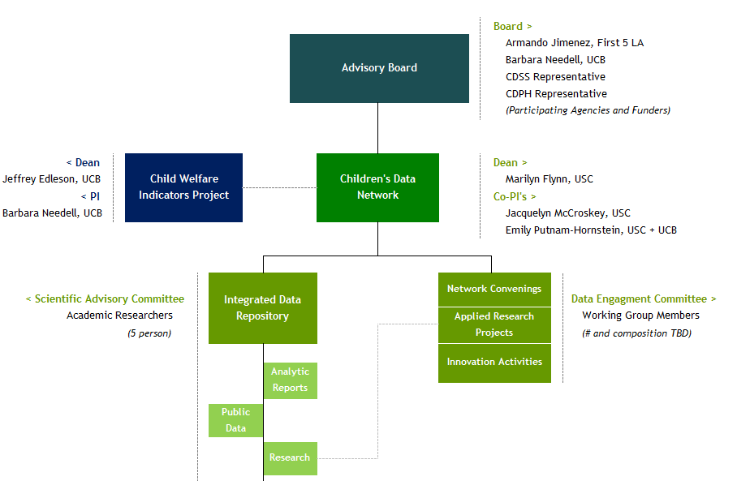
Proposed governance

Slide 10
Data Sharing Agreements
CDN enters into a direct data-sharing MOU with a given State or County agency (either a new MOU or by extending an existing MOU via partnership with the Child Welfare Indicator’s Project); or
CDN requests pre-approved data elements prepared for release to approved researchers
data
formal MOU
researcher access

Slide 11
Data Integration Process?
Record from Agency B
(id = Yt9hU4)
Record from Agency A
(id = A4568)
Re-integration with Confidential / Clinical Information
Record from Agency C
(id = 9978)
Master ID | Agency A | Agency B | Agency C
1f567 | A4568 | Yt9hU4 | 9978
Master Data Management Software
Ongoing Probabilistic De-duplication of Data Repository
Master ID = 1f567

Slide 12
Data Transfer process

Slide 13
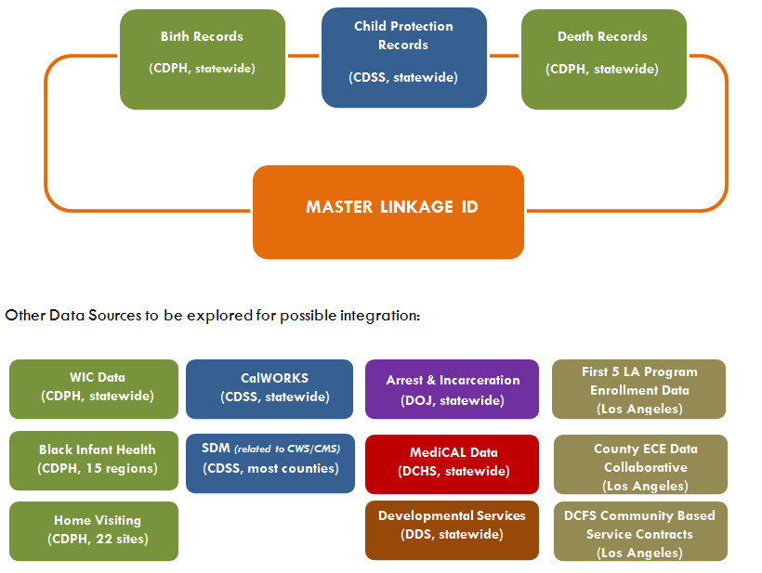
Potential sources of Data

Slide 14
Data Management
First 5 LA
Other funders?
Children’s Data Network
Integrated Child Indicators
Research
Analytic Reports
Personal Information Used for Linkage
De-Identified, Linked Data
Cloud Server
Public
Child Welfare Indicators Project
Child Welfare Performance Indicators
CDSS
Stuart Foundation
Technical Assistance

Slide 15
Development of Prospective Policy and program questions…
risks
outcome
prospective
retrospective

Slide 16
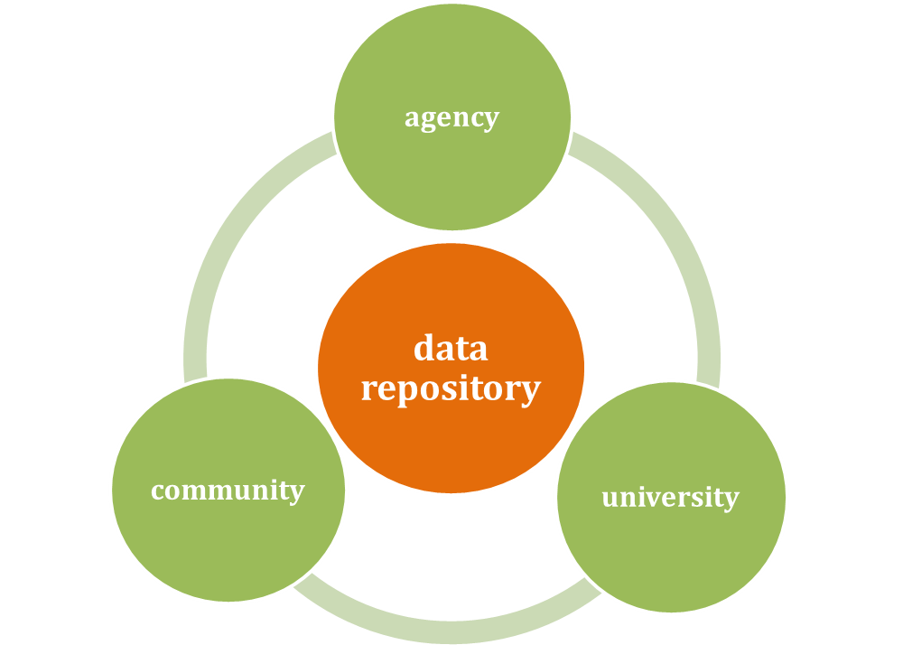
A shared resource
The purpose of developing a children’s data repository is to facilitate applied, actionable research to support data-driven policy and programmatic decisions critical to young children and their families.
By creating a repository, a growing body of integrated data will be developed, data that can then serve as the basis for attending to a range of policy questions from different stakeholders.

Slide 17
questions? interest? ehornste@usc.edu mccroske@usc.edu

