Slide 1



CCWIP Data Analysis Training
Using the CCWIP Website to Answer Questions about Key Child Welfare Outcomes
Wendy Wiegmann
CCWIP
January 19, 2016

Slide 2
Outline
Review some important concepts underlying child welfare data measurement.
Explore the methodologies for the seven Federal CFSR3 measures.
Introduce and examine features of the CCWIP website and key data indicators for California’s children.

Slide 3
child welfare data measurement

Slide 4
Counterbalanced Indicators of
System Performance
rate of referrals/
substantiated referrals
home-based services vs.
out of home care
reentry to care
permanency
through reunification,
adoption, or
guardianship
use of least
restrictive
form of care
length
of stay
positive attachments to family, friends, and neighbors
stability of care
Source: Usher, C.L., Wildfire, J.B., Gogan, H.C. & Brown, E.L. (2002). Measuring Outcomes in Child Welfare. Chapel Hill, NC: Jordan Institute for Families,
Notes:
We really know that child welfare data measurement includes many different outcomes, some which may work against others. Child welfare agencies are striving for a balance between these multiple indicators.

Slide 5
3 Key Data Views in Child Welfare
Data
Entry
Cohorts
Exit
Cohorts
Point
in Time
Notes:
In addition to the issue of different (and sometimes competing) measures, it is also important to understand that the data can be examined multiple way, some of which give an accurate picture of what happened/happens to a child in the child welfare system, and others which may skew the picture.
The first question that has to be answered is, “Whose outcomes do I want to measure?”
There basic are 3 choices:
Children in foster care - the active caseload (other terms: point-in-time, cross-section, or census)
Children leaving foster care - children who left placement in the last year (other terms: an exit cohort)
Children entering foster care - children placed during some period of time, usually one year (other terms: an admission cohort)
Each of these approaches represents a different way to sample the children who have ever been in foster care

Slide 6
What is the difference?
Cross-Sectional/Point-in-time - Only children in care
Exit cohort - Only children who left care
Entry cohort - All children who entered

Slide 7
What are the implications?
It is much harder to measure outcomes over time using either a point-in-time or an exit cohort sample because the samples are missing some children:
  A point-in-time analysis is missing the kids who left placement
  An exit cohort only includes kids who leave
  You can’t assess change if you leave out either of these children because their experiences aren’t factored into the outcomes. All children have to be included in the system for monitoring outcomes.

Slide 8
PIT Snapshots vs Entry Cohorts
Jan. 1, 2015
Jan. 1, 2014
Jan. 1, 2016
Notes:
Another problem with point-in-time data: the over-capture of long-stayers.

Slide 9
Tracking an Entry Cohort for 1 Year
2014
2015
Dec. 31
Dec. 31
Jul. 7
Jul. 7
Mar. 1
Mar. 1
Jan. 1
Dec. 31
Jan. 1
Dec. 31
Notes:
How Entry Cohorts work

Slide 10
federal CFSR3 measures

Slide 11
Outcomes: Safety
Children are, first and foremost, protected from abuse and neglect.
Children are safely maintained in their homes whenever possible and appropriate.

Slide 12
CFSR3: Data Indicators
Safety
  S1: Maltreatment in foster care
  “Of all children in care during the 12-month period, what is the rate of victimization per day?”
  S2: Recurrence of maltreatment
  “Of all children with a substantiated allegation during the 12-month period, what percent had another substantiated allegation within 12 months?”
Notes:
S1: Of all children in foster care during a 12-month period, what is the rate of victimization per day of foster care?
What’s changed from CFSR 2?
Rate of maltreatment per child days in foster care vs. percentage of children not maltreated in foster care
Includes all maltreatment types by any perpetrator vs. just maltreatment by foster parents/facility staff
Includes:
All days in foster care during the year (across episodes)
Multiple incidents of substantiated maltreatment for the same child are included in the numerator
Excludes:
Children in care for less than 8 days
Incidents occurring before or within 7 days of the date of removal
Children age 18+
Days in care after 18th birthday
S2: Of all children who were victims of a substantiated report of maltreatment during a 12-month reporting period, what percent were victims of another substantiated maltreatment allegation within 12 months of their initial report?
What’s changed from CFSR 2?
Window is 12 months vs. 6 months
Recurrence vs. no recurrence
Excludes:
Children age 18+ at initial report
Substantiated allegations occurring within 14 days of initial report

Slide 13
  S1: Maltreatment in foster care
Cohort: Children in Care Between Apr 2015 – Mar 2016
Child A
Days in care: 275
Instances of maltreatment: 0
1
Denominator: total days in care
275 + 45 + 310 + 95 + 188 = 913
2
Numerator: instances of maltreatment
0 + 1 + 2 + 0 + 0 = 3
Child B
Days in care: 45
Instances of maltreatment: 1
3
Calculate rate of maltreatment per day in care
3 / 913 = 0.003286
Child C
Days in care: 310
Instances of maltreatment: 2
4
Multiply by 100,000
0.003286 * 100,000 = 328.6 victimizations
per 100,000 days in foster care
Child D
Days in care (episode 1): 95
Instances of maltreatment: 0
Days in care (episode 2): 188
Instances of maltreatment: 0
National Standard:
<= 8.50 per 100,000
Notes:
S1: “Of all children in care during the 12-month period, what is the rate of victimization per day?”
Days in care – across episodes
Maltreatment – includes multiple instances/child
If hiding the next slide: data on example children:
Child A entered care 12/17/12 and turned 18 on 9/19/13.
Child B entered care on 1/15/13, exited care on 2/19/13, and the substantiated report of maltreatment occurred on 1/18/13.
Child C entered care 11/24/12 and was still in care on the last day of the 12-month period. Substantiated reports of maltreatment occurred on 1/30/13 and 4/15/13.
Child D had two episodes in care. The first started on 5/9/12 and ended on 1/4/13. The second started on 3/21/13 and ended 9/25/13.

Slide 14
  S2: Recurrence of maltreatment
04/1/14
4/1/15
4/1/16
Children with a substantiated allegation during the 12-month period: 6
Children with another substantiated allegation within 12 months: 3
Performance (P1): 50%
National Standard: <=9.1%
Notes:
S2: “Of all children with a substantiated allegation during the 12-month period, what percent had another substantiated allegation within 12 months?”
Child 1: 7 months, first substantiated allegation prior to 12-month period
Child 2: 20 months, first substantiated allegation during 12-month period, second substantiated allegation after 12 months
Child 3: 17 months, first substantiated allegation prior to 12-month period
Child 4: 9 months, first substantiated allegation during 12-month period, second substantiated allegation within 12 months
Child 5: 4 months, first substantiated allegation prior to 12-month period
Child 6: 20 months, first substantiated allegation during 12-month period, no second allegation
Child 7: 5 months, first substantiated allegation during 12-month period, second substantiated allegation within 12 months
Child 8: 22 months, first substantiated allegation during 12-month period, second substantiated allegation after 12 months
Child 9: 2 months, first substantiated allegation prior to 12-month period
Child 10: 7 months, first substantiated allegation during 12-month period, second substantiated allegation within 12 months

Slide 15
Outcomes: Permanency
Children have permanency and stability in their living arrangements.
The continuity of family relationships and connections is preserved for children.

Slide 16
CFSR3: Data Indicators
Permanency
  P1: Permanency in 12 months for children entering foster care
  “Of all children who entered care in the 12-month period, what percent discharged to permanency within 12 months?”
  Trial Home Visit (THV) Adjustment: Children who have a discharge to reunification that was preceded by a trial home visit will have their length of stay adjusted to be at the time of the entry to the THV plus 30 days…and THV +30 will be considered the date they exited to permanency, even if the actual episode ends later.
Notes:
P1: Of all children who enter foster care in a 12-month period, what percent discharged to permanency within 12 months of entering foster care?
What’s changed from CFSR 2?
Expanded definition of permanence includes reunification, adoption, or guardianship vs. reunification only
Includes all children entering foster care during the year vs. just those who were removed for the first time
Entry cohort window is 12 months vs. 6 months
Excluded:
Children in care for less than 8 days
Children entering care at age 18+

Slide 17
  P1: Permanency in 12 months for children entering foster care
04/1/14
4/1/15
4/1/16
Children entering care during the year: 6
Children achieving permanency within 12 months: 4
Performance (P1): 67%
National Standard: >=40.5%
Notes:
P1: “Of all children who enter foster care in a 12-month period, what percent discharged to permanency within 12 months of entering foster care?”
Child 1: 7 months, entered care prior to 12-month period, exit to reunification
Child 2: 2 months, entered care during 12-month period, exit to reunification
Child 3: 17 months, entered care prior to 12-month period, exit to reunification, but not within 12 months
Child 4: 9 months, entered care during 12-month period, exit to guardianship
Child 5: 4 months, entered care prior to 12-month period, exit to reunification
Child 6: 20 months, entered care during 12-month period, no exit
Child 7: 5 months, entered care during 12-month period, exit to reunification
Child 8: 17 months, entered care during 12-month period, exit to reunification, but not within 12 months
Child 9: 2 months, entered care prior to 12-month period, exit to reunification
Child 10: 7 months, entered care during 12-month period, exit to reunification

Slide 18
CFSR3: Data Indicators
Permanency (con’t)
  P2/P3: Permanency in 12 months for children in foster care for 12-23 months (P2) or for 24 months or more (P3)
  “Of all children in care on the first day of the 12-month period who had been in care between 12 and 23 months (P2) or for 24 months or more (P3), what percent discharged to permanency within 12 months?”
Notes:
P2/P3: Of all children in foster care on the first day of the 12-month period, who had been in foster care (in that episode) for 12-23 months (P2) or for 24 months or more (P3), what percent discharged to permanency within 12 months of the first day?
What’s changed from CFSR 2?
P2 is a new measure with an intermediate time period (between 12 and 23 months)
Excludes:
Children who were age 18+ on the first day of the year
No Trial Home Visit adjustment

Slide 19
  P2/P3: Entry & Length of Stay for months
4/1/12
4/1/13
4/1/14
4/1/15
4/1/16
Children in care less than 12 months prior to censor date: 4
Children in care for 12-23 months prior to censor date: 6
Children in care for more than 24 months prior to censor date: 5
Notes:
Child 1: No time prior to first day, exit to reunification (7 months total)
Child 2: 23 months prior to first day, no exit (more than 48 months total)
Child 3: 1 month prior to first day, exit to reunification (2 months total)
Child 4: 36 months prior to first day, exit to adoption (46 months total)
Child 5: 24 months prior to first day, exit to reunification (30 months total)
Child 6: 12 months prior to first day, exit to guardianship (14 months total)
Child 7: 10 months prior to first day, no exit (37 months total)
Child 8: 14 months prior to the first day, exit to reunification (22 months total)
Child 9: 22 months prior to the first day, exit to guardianship (46 months total)
Child 10: 18 months prior to the first day, exit to adoption (20 months total)
Child 11: 25 months prior to the first day, exit to adoption (38 months total)
Child 12: No time prior to first day, exit to reunification (6 months total)
Child 13: 27 months prior to the first day, exit to adoption (34 months total)
Child 14: 14 months prior to the first day, exit to reunification (18 months total)
Child 15: No time prior to the first day, exit to reunification (2 months total)
Child 16: 30 months prior to the first day, exit to guardianship (48 months total)
Child 17: 1 month prior to first day, exit to reunification (13 months total)
Child 18: 6 months prior to the first day, exit to adoption (11 months total)

Slide 20
  P2: Permanency in 12 months for children in care for 12-23 months
4/1/12
4/1/13
4/1/14
4/1/15
4/1/16
Children in care on the first day of the censor year who had been in care for 12-23 months: 6
Children achieving permanency within 12 months of censor date: 4
Performance (P2): 67%
National Standard: >=43.6%
Notes:
P2: “Of all children in care on the first day of the 12-month period who had been in care between 12 and 23 months, what percent discharged to permanency within 12 months?”
Child 1: No time prior to first day, exit to reunification (7 months total)
Child 2: 23 months prior to first day, no exit (more than 48 months total)
Child 3: 1 month prior to first day, exit to reunification (2 months total)
Child 4: 36 months prior to first day, exit to adoption (46 months total)
Child 5: 24 months prior to first day, exit to reunification (30 months total)
Child 6: 12 months prior to first day, exit to guardianship (14 months total)
Child 7: 10 months prior to first day, no exit (37 months total)
Child 8: 14 months prior to the first day, exit to reunification (22 months total)
Child 9: 22 months prior to the first day, exit to guardianship (46 months total)
Child 10: 18 months prior to the first day, exit to adoption (20 months total)
Child 11: 25 months prior to the first day, exit to adoption (38 months total)
Child 12: No time prior to first day, exit to reunification (6 months total)
Child 13: 27 months prior to the first day, exit to adoption (34 months total)
Child 14: 14 months prior to the first day, exit to reunification (18 months total)
Child 15: No time prior to the first day, exit to reunification (2 months total)
Child 16: 30 months prior to the first day, exit to guardianship (48 months total)
Child 17: 1 month prior to first day, exit to reunification (13 months total)
Child 18: 6 months prior to the first day, exit to adoption (11 months total)

Slide 21
  P3: Permanency in 12 months for children in care for 24+ months
4/1/12
4/1/13
4/1/14
4/1/15
4/1/16
Children in care on the first day of the censor year who had been in care for more than 24 months: 5
Children achieving permanency within 12 months of censor date: 3
Performance (P3): 60%
National Standard: >=30.3%
Notes:
P3: “Of all children in care on the first day of the 12-month period who had been in care for 24 months or more, what percent discharged to permanency within 12 months?”
Child 1: No time prior to first day, exit to reunification (7 months total)
Child 2: 23 months prior to first day, no exit (more than 48 months total)
Child 3: 1 month prior to first day, exit to reunification (2 months total)
Child 4: 36 months prior to first day, exit to adoption (46 months total)
Child 5: 24 months prior to first day, exit to reunification (30 months total)
Child 6: 12 months prior to first day, exit to guardianship (14 months total)
Child 7: 10 months prior to first day, no exit (37 months total)
Child 8: 14 months prior to the first day, exit to reunification (22 months total)
Child 9: 22 months prior to the first day, exit to guardianship (46 months total)
Child 10: 18 months prior to the first day, exit to adoption (20 months total)
Child 11: 25 months prior to the first day, exit to adoption (38 months total)
Child 12: No time prior to first day, exit to reunification (6 months total)
Child 13: 27 months prior to the first day, exit to adoption (34 months total)
Child 14: 14 months prior to the first day, exit to reunification (18 months total)
Child 15: No time prior to the first day, exit to reunification (2 months total)
Child 16: 30 months prior to the first day, exit to guardianship (48 months total)
Child 17: 1 month prior to first day, exit to reunification (13 months total)
Child 18: 6 months prior to the first day, exit to adoption (11 months total)

Slide 22
CFSR3: Data Indicators
Permanency (con’t)
  P4: Re-entry to foster care
  “Of all children who enter care in the 12-month period who discharged within 12 months to reunification or guardianship, what percent re-enter foster care within 12 months.”
  P5: Placement stability
  “Of all children who enter care in the 12-month period, what is the rate of placement moves per day?”
Notes:
P4: Of all children who enter foster care in a 12- month period and are discharged within 12 months to reunification or guardianship, what percent re-entered foster care within 12 months of their date of discharge?
What’s changed from CFSR 2?
Entry cohort (denominator includes all children who enter care during the year and exit within 12 months) vs. all children who exit during the year
Includes exits to reunification and guardianship vs. reunification only
Excluded:
Children in care for less than 8 days
Children entering or exiting care at age 18+
Note:
If a child has multiple re-entries to foster care within 12 months of their discharge, only the first re-entry is selected.
P5: Of all children who enter foster care in a 12- month period, what is the rate of placement moves per day of foster care?
What’s changed?
Entry cohort vs. all children in care for less than 12 months
Controls for time in care by constructing a moves/placement day vs. the number of moves per child
Accurately accounts for actual number of moves vs. the prior “2 or more” indicator
Excluded:
Children in care for less than 8 days
Children entering or exiting care at age 18+
Note:
The initial removal from home (and into foster care) is not counted as a placement move.

Slide 23
  P4: Re-Entry to Foster Care
04/1/14
4/1/15
4/1/16
Children entering care during the year: 6
Children achieving permanency within 12 months: 4
Children reentering foster care within 12 months of date of discharge: 2
Performance (P4): 50%
National Standard: <=8.3%
8 months
4 months
Notes:
P4: “Of all children who enter foster care in a 12- month period and are discharged within 12 months to reunification or guardianship, what percent re-entered foster care within 12 months of their date of discharge?”
Child 1: 7 months, entered care prior to 12-month period, exit to reunification
Child 2: 2 months, entered care during 12-month period, exit to reunification
Child 3: 17 months, entered care prior to 12-month period, exit to reunification, but not within 12 months
Child 4: 9 months, entered care during 12-month period, exit to guardianship
Child 5: 4 months, entered care prior to 12-month period, exit to reunification
Child 6: 20 months, entered care during 12-month period, no exit
Child 7: 5 months, entered care during 12-month period, exit to reunification
Child 8: 17 months, entered care during 12-month period, exit to reunification, but not within 12 months
Child 9: 2 months, entered care prior to 12-month period, exit to reunification
Child 10: 7 months, entered care during 12-month period, exit to reunification

Slide 24
P5: Placement Stability
Cohort: Children Entering Care Between Apr 2013 – Mar 2014
Child A
Days in care: 342
Placement moves: 2
1
Denominator: total days in care
342 + 196 + 35 + 167 + 154 = 894
2
Numerator: placement moves
2 + 0 + 1 + 1 + 0 = 4
Child B
Days in care: 196
Placement moves: 0
3
Calculate rate of moves per day in care
4 / 894 = 0.00447
Child C
Days in care (episode 1): 35
Placement moves: 1
Days in care (episode 2): 167
Placement moves: 1
4
Multiply by 1,000
0.00447 * 1,000 = 4.5 placement moves per
1,000 days in foster care
Child D
Days in care: 154
Placement moves: 0
National Standard:
<= 4.12 per 1,000
Notes:
P5: “Of all children who enter care in the 12-month period, what is the rate of placement moves per day?”
Days in care/placement moves – across episodes
If hiding the next slide: data on example children:
Child A entered care 4/23/13 and had two placement moves on 5/1/13 and 9/30/13. Still in care at the end of the year
Child B entered care 6/22/13 and exited 1/14/14
Child C had two episodes: the first started on 5/4/13 and ended 6/8/13 with one placement move on 5/12/13; the second started on 10/15/13 with one placement move on 12/26/13. Still in care at the end of the year
Child D entered care on 8/30/13 and turned 18 on 2/1/14. One placement move after 18th birthday on 2/27/14

Slide 25
Outcomes: Well-Being
Families have enhanced capacity to provide for their children's needs.
Children receive appropriate services to meet their educational needs.
Children receive adequate services to meet their physical and mental health needs.

Slide 26
The California Child Welfare Indicators Project (CCWIP)

Slide 27
CCWIP Overview
Aggregates California’s administrative child welfare data into customizable tables that are refreshed quarterly and made available on a public website
Provides stakeholders with direct access to information on California’s entire child welfare system to examine performance measures over time
Data can be stratified and filtered by year, county, age, ethnicity, gender, placement type, and other subcategories

Slide 28
Where do the data come from?
Data entered by county social workers
Compiled by IBM
“Data dump” received by CCWIP
Longitudinally configured
Used for quarterly reports
Data used to track outcomes
Published on public website

Slide 29
Activity: “Exploring CCWIP Data”
first allegation of maltreatment
allegation evaluated out
second allegation of maltreatment
allegation substantiated
pre-placement family maintenance services provided
child placed in out-of-home foster care
child reunified
third allegation of maltreatment
child re-enters foster care
Notes:
This is an example of what kind of system level information about children’s pathways through the system – there is more information available on the site such as disparities, placement with siblings, and placement distances.

Slide 30
website
http://cssr.berkeley.edu/ucb_childwelfare/

Slide 31
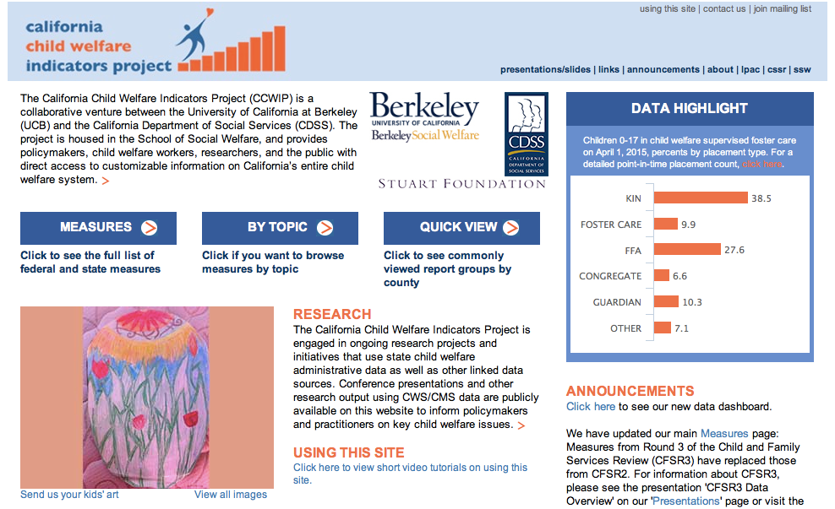
Website

Slide 32
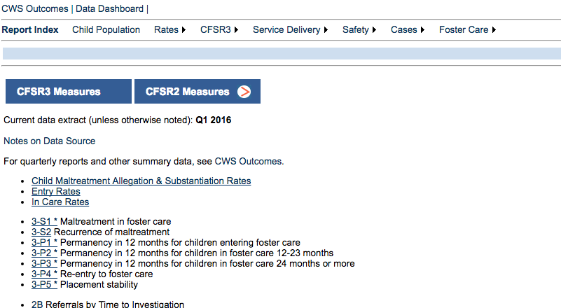
Report Index

Slide 33
Computing a Percent
PERCENT: A proportion in relation to a whole expressed as a fraction of 100.
% percent (per 100) = x 100
part
___
total

Slide 34
Computing a Rate per 1,000
RATE: A proportion in relation to a whole, can be expressed as a fraction of 100, 1000, 100,000, etc.
rate per 1000 = x 1000
part
___
total
Notes:
Why do we use rate per 1,000 vs per 100 or per 10,000?

Slide 35
Computing a Rate per 1,000
What was the child maltreatment allegation rate for children in California in 2015? (i.e., how many children were the subject of a child maltreatment allegation out of all possible children in the population?)
# allegations
______________
# child population
x 1000
Raw Numbers (counts)
# Allegations = 501,411
# Child population = 9,102,486
501,411
= _________ X 1000
9,102,486
= 0.055 x 1000
Scales for a meaningful interpretation and comparison.
= 55.1
Notes:
Data is from the Child Maltreatment Allegation and Substantiation Rates (California): http://cssr.berkeley.edu/ucb_childwelfare/RefRates.aspx
By multiplying by 1000, we translate the raw number (501,411) into a rate that we can interpret (55.1). This also allows us to compare across counties and across states as the numbers we are comparing are now on the same scale (i.e. per 1000).

Slide 36
Please complete exercises
1a through 1c
Worksheet:

Slide 37
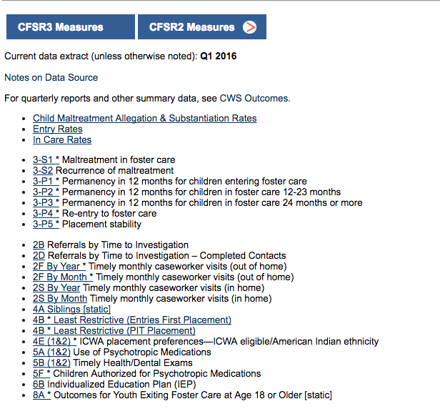
Federal (CFSR) Measures

Slide 38
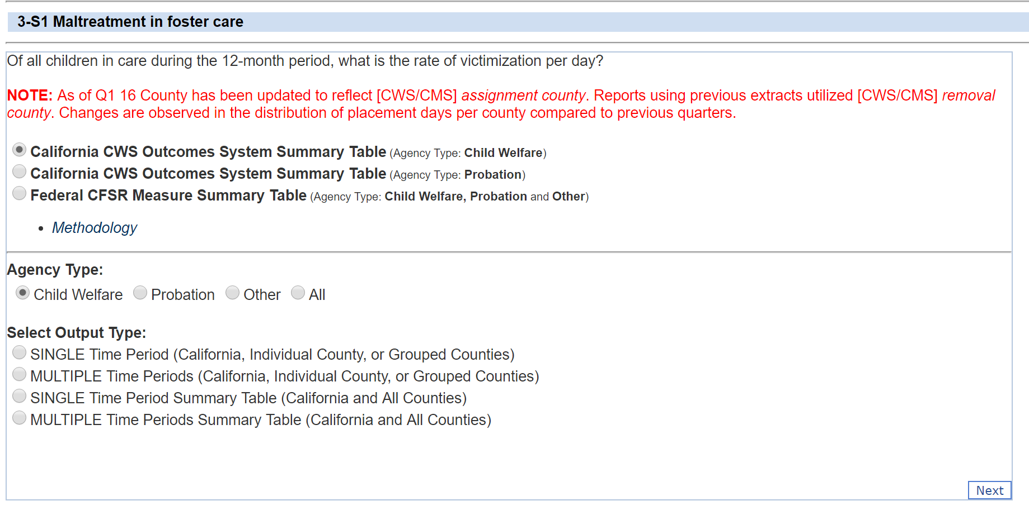
Methodology Links

Slide 39
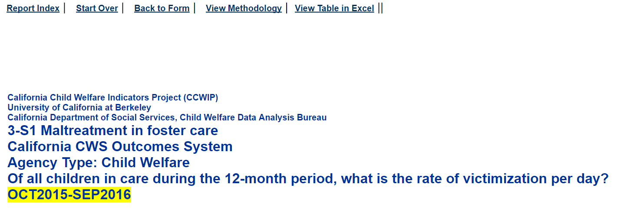
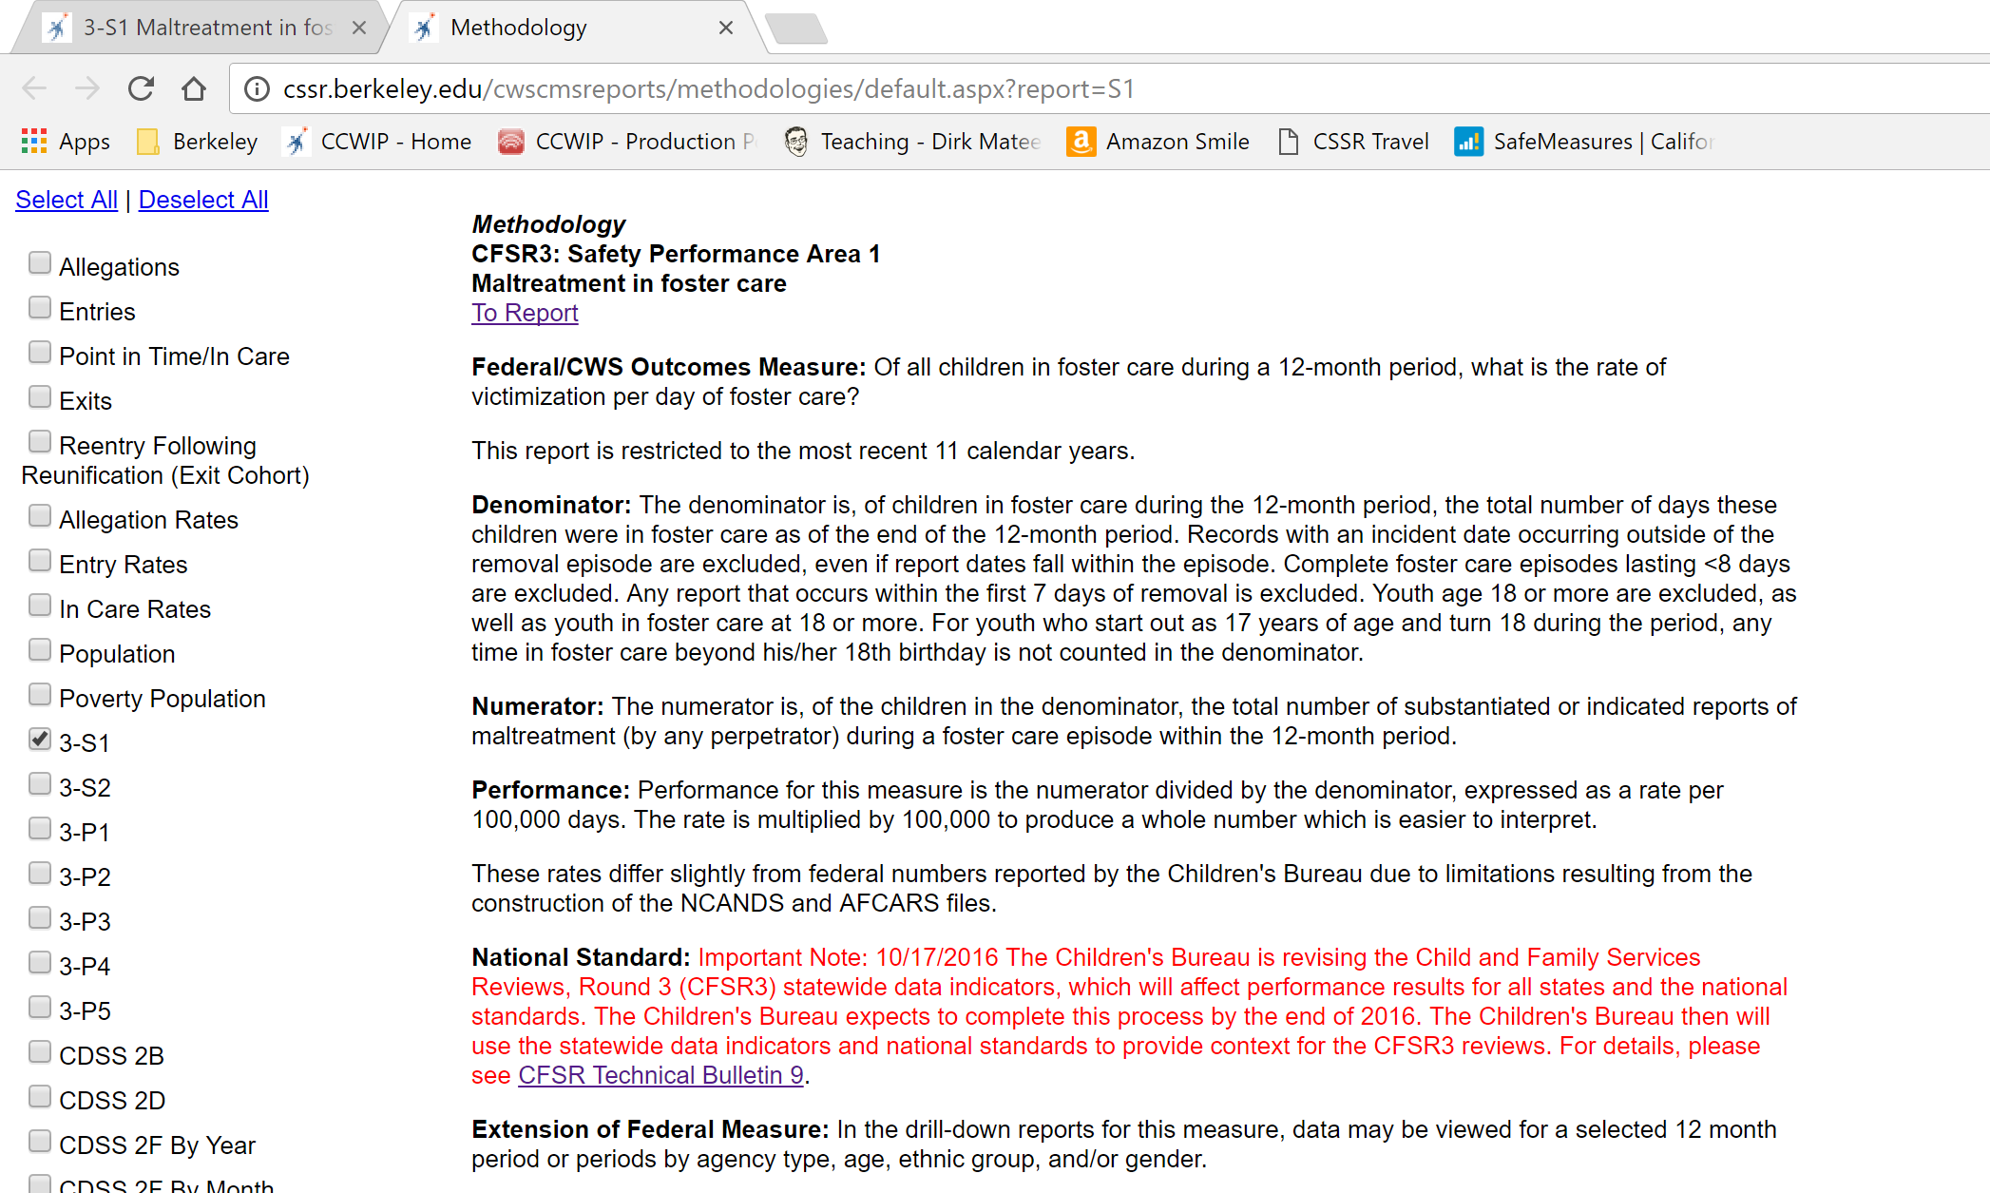
Methodology Links (con’t)

Slide 40
Please complete exercises
2a THROUGH 2D
Worksheet:

Slide 41
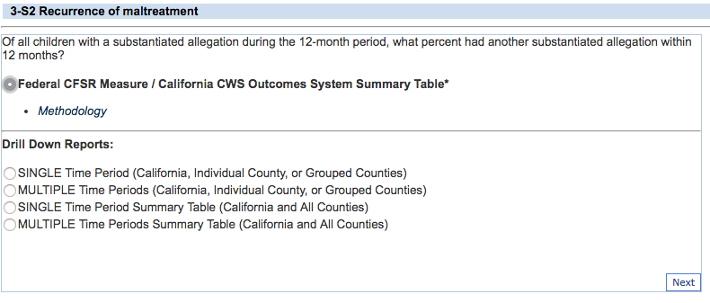
Federal CFSR Summaries

Slide 42
Please complete exercises
3a through 3D
Worksheet:

Slide 43
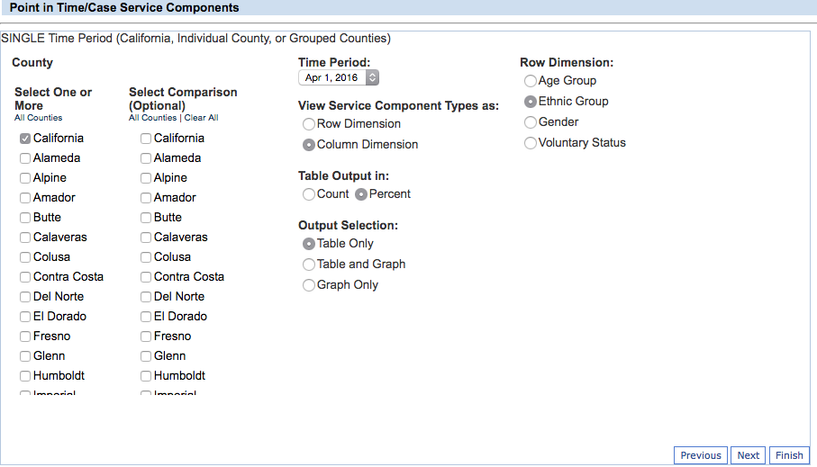
Row & Column Dimensions

Slide 44
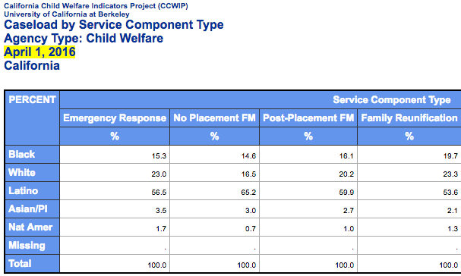
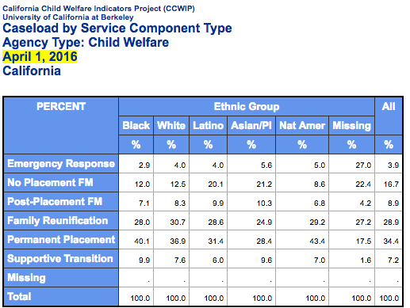
Service Component as
Row & Column Dimensions
Row
Column

Slide 45
Please complete exercises
4a & 4b
Worksheet:

Slide 46
Disproportionality vs. Disparity
Disproportionality: When a group makes up a proportion of those experiencing some event that is higher or lower than that group’s proportion of the population
Disparity: A comparison of one group (e.g., regarding disproportionality, services, outcomes) to another group

Slide 47
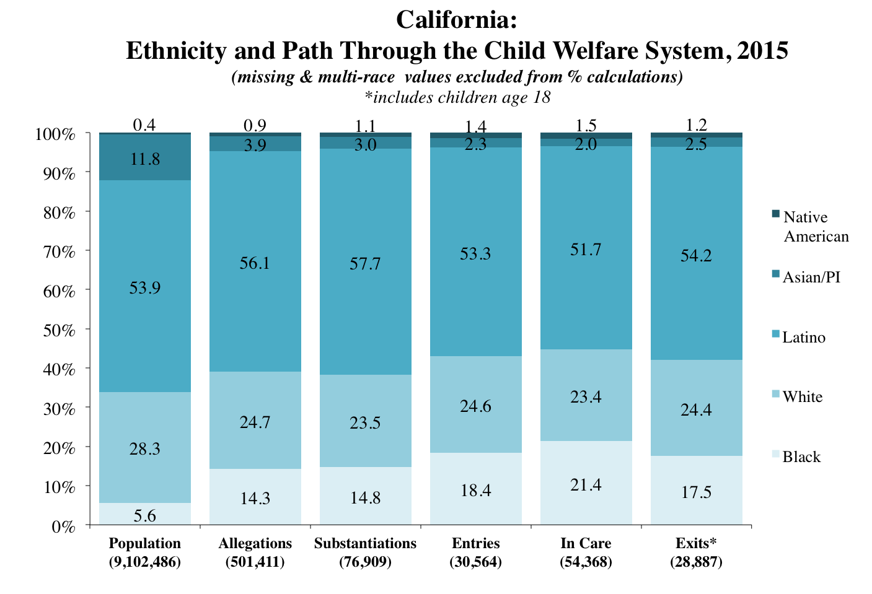

Slide 48
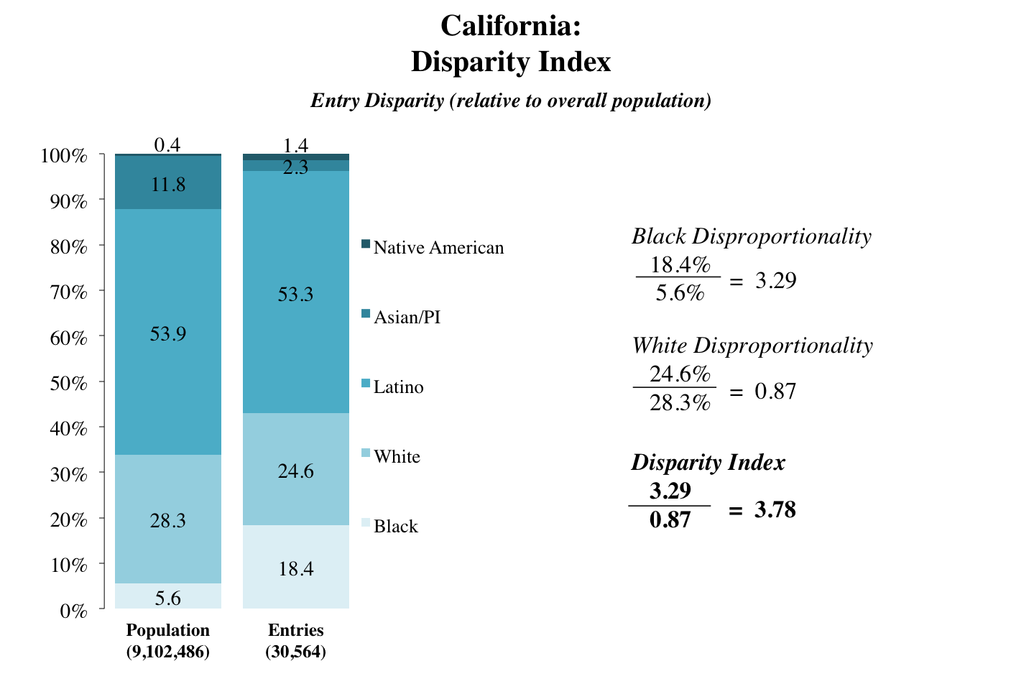
“Black children are 3.78 times more likely to enter care than white children.”

Slide 49
Please complete exercises
5a through 5c
Worksheet:

Slide 50
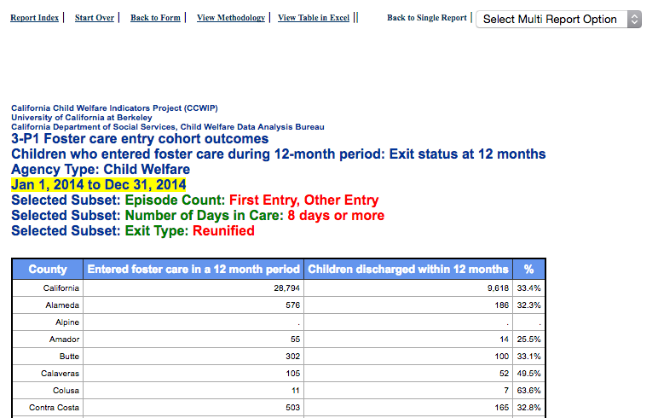
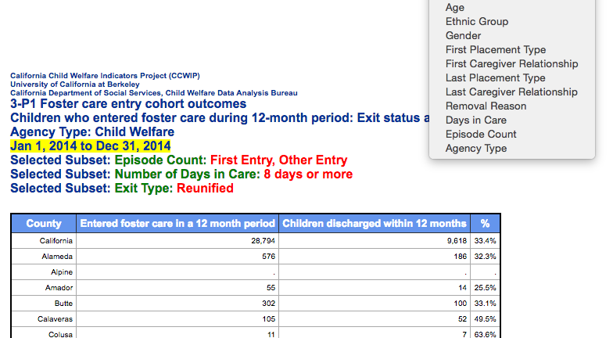
Multi-Report Option

Slide 51
Please complete exercises
6a & 6b
Worksheet:

Slide 52
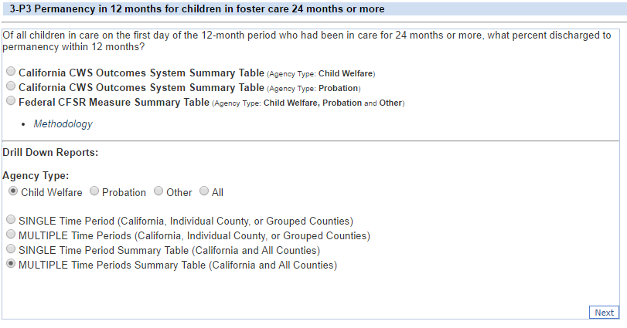
Multiple Time Periods

Slide 53
Please complete exercises
7a & 7b
Worksheet:

Slide 54
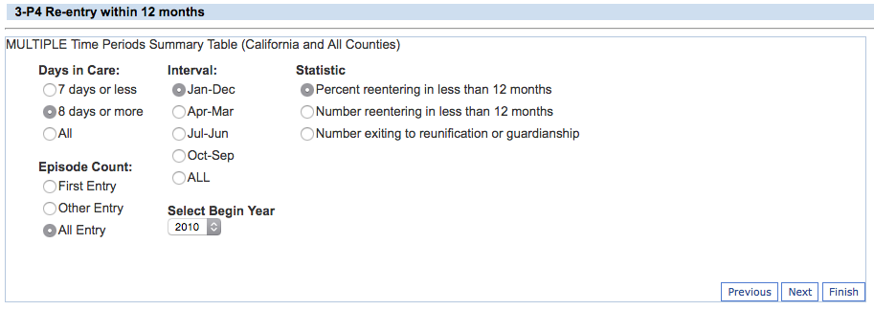
Additional Subgroup Filters

Slide 55
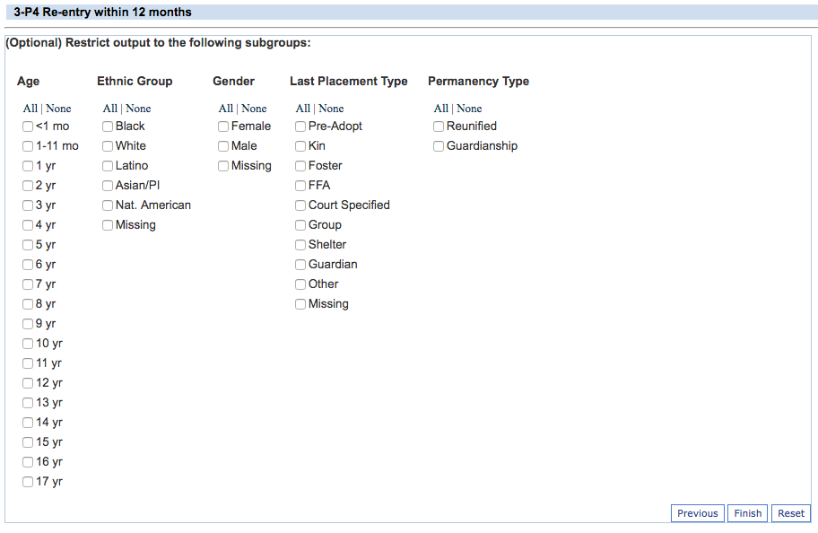
Additional Subgroup Filters

Slide 56
Please complete exercises
8a through 8c
Worksheet:

Slide 57
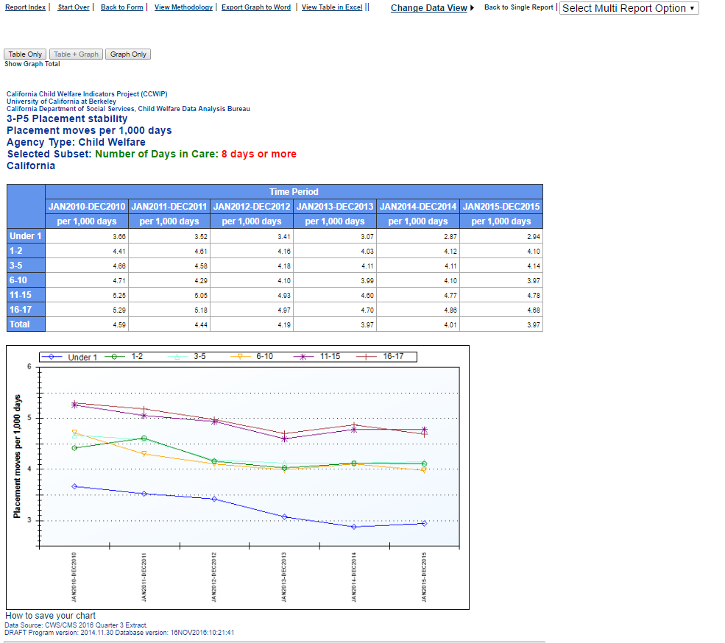
Exporting Tables & Charts

Slide 58
Please complete exercises
9a & 9B
Worksheet:

Slide 59
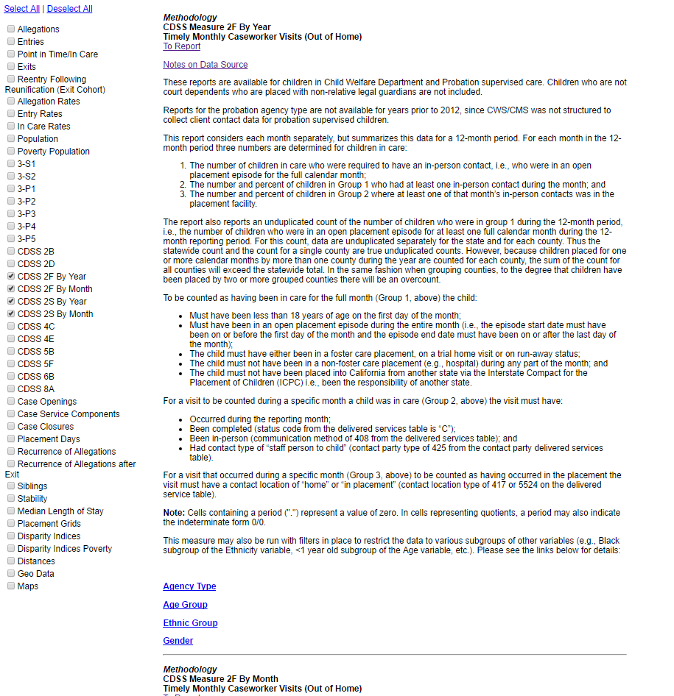
Reviewing/Comparing
Multiple Methodologies

Slide 60
Please complete exercises
10a through 10c
Worksheet:

Slide 61



Thank You!
  The California Child Welfare Indicators Project (CCWIP) is a collaboration of the California Department of Social Services and the School of Social Welfare, University of California at Berkeley, and is supported by the California Department of Social Services, the Stuart Foundation, and the Conrad N. Hilton Foundation.
Notes:
CCWIP is a collaboration of the California Department of Social Services and the School of Social Welfare, University of California at Berkeley, and is supported by the California Department of Social Services and the Stuart Foundation.

