Slide 1
The Performance Indicators Project
& the Administrative Office of the Courts:
Toward Using Child Welfare Data in the Court Context
Daniel Webster, MSW PhD
Center for Social Services Research
University of California, Berkeley
Panel on Data and Child Outcome Measures:
Joint Ownership of Permanency & Safety
Court Improvement Project Convening
Casey Family Programs
Savannah, GA
October 2012
Presentation originally created by William C Dawson & Amy C Nuñez
CENTER FOR SOCIAL SERVICES RESEARCH
School of Social Welfare, UC Berkeley

Slide 2
Child Welfare Data in California: The Performance Indicators Project
Child Welfare Dynamic Report System:
http://cssr.berkeley.edu/ucb_childwelfare/
Data from the statewide Child Welfare Services Case Management System (CWS/CMS)
A Collaborative Effort
California Department of Social Services
Center for Social Services Research, UC Berkeley
Stuart Foundation
Casey Family Programs
And others!
Notes:
All Child Welfare Data in this file are drawn from Child Welfare Dynamic Report System
A California Department of Social Services / University of California at Berkeley collaboration
funded by CDSS and the Stuart Foundation.
The web site is provides reports information about children and youth involved with California’s child welfare system. Data are drawn from CWS/CMS, California’s SACWIS, and the site is public.

Slide 3
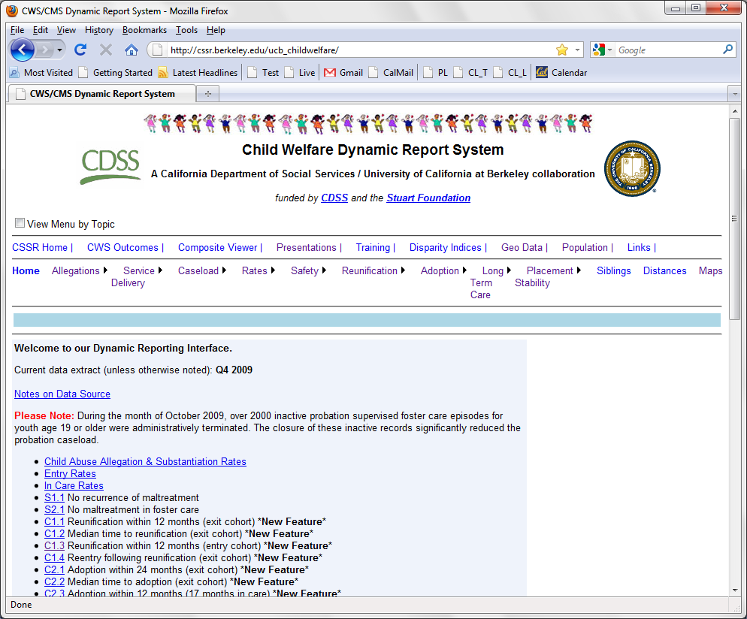
Notes:
All Child Welfare Data in this file are drawn from Child Welfare Dynamic Report System
A California Department of Social Services / University of California at Berkeley collaboration
funded by CDSS and the Stuart Foundation.
The web site is provides reports information about children and youth involved with California’s child welfare system. Data are drawn from CWS/CMS, California’s SACWIS, and the site is public.

Slide 4
Dependency Court Data in CA
AOC responds to requests for data on California’s dependency caseload
58 counties in the state
No statewide case management system
Common statewide element: Case Filings
Notes:
The Administrative Office of the Courts (AOC) responds to numerous requests for descriptive statistics on California’s juvenile dependency caseload. CA has 58 counties that do not share a centralized case management system. With the exception of data on juvenile dependency court filings, which are available though the Judicial Branch Statistical Information System, the AOC relies on publically accessible data from California’s child welfare data system (CWS/CMS) to fulfill data requests. Absent a statewide court case management system, the CWS/CMS is currently the only source of data that is consistently updated and available at both the state and county level.
In order to provide courts with the most frequently requested data, the Center for Social Services Research at UC Berkeley and the Administrative Office of the Courts have collaborated to create a series of county-level reports entitled Child Welfare County Data Profiles for the Courts. To the greatest extent possible, using a data source external to the courts, these reports have been designed to meet the data needs of judicial officers, court managers and court executives.

Slide 5
Partnership between AOC & CDSS/UCB
Excel Tool
Court-related variables
Developed User’s Guide
Includes voluntary & court-ordered placements
Convenient access to selected summary data
Making data relevant to non-researchers
Allows for statewide comparison
Allows courts & child welfare to align outcome measures
Notes:
Excel tool is refreshed twice yearly and all values are calculated for California and each of CA’s 58 counties.
Selected topics and analyses of interest to court users.
Many data are stratified by children receiving court-ordered/voluntary family maintenance and children in court-dependent/non-court-dependent foster care.
There are a lot of reports on the website, so this Excel file selects reports of interest and doesn’t require the user to be expert in the use of the site to make use of the data. The hope is that, for some users, this will provide an introduction to the data and encourage use of the site to answer in-depth questions.
Worked extensively to gather feedback with judges and CEOs around the state, needed to address concerns about small county (with small cells-under 50 cases) and data discrepancies (between court and child welfare reports).

Slide 6
County Data Profiles for the Courts
California Judicial Branch website:
http://www.courts.ca.gov/
Foster Care Workload
Placement Types
Data Levels of Detail
Dashboard
County Profile Report
Dynamic Website Analyses
Notes:
Other features of county profile reports:
-- links to source reports on CWS/CMS reports website to allow users to further explore data
--Data restricted to court ordered cases / court dependent placements when possible
--Custom data views as requested by AOC (e.g., combination of Family Maintenance and Foster Care caseloads in one view and custom in care placement type groupings) [see explanation below]
--County/State and County side by side table and graph comparisons
--% change between timeframes
--Presents data from child welfare and court sources (filings)
--Custom footnotes and endnotes developed with court audience in mind
--Static (excel, pdf) and dynamic (excel) versions available
--(Dynamic version) % change between user-selected time frames. Selected time frames are dynamically marked on tables and charts
--(Dynamic version) Presents all available time frames in four views (intervals)

Slide 7
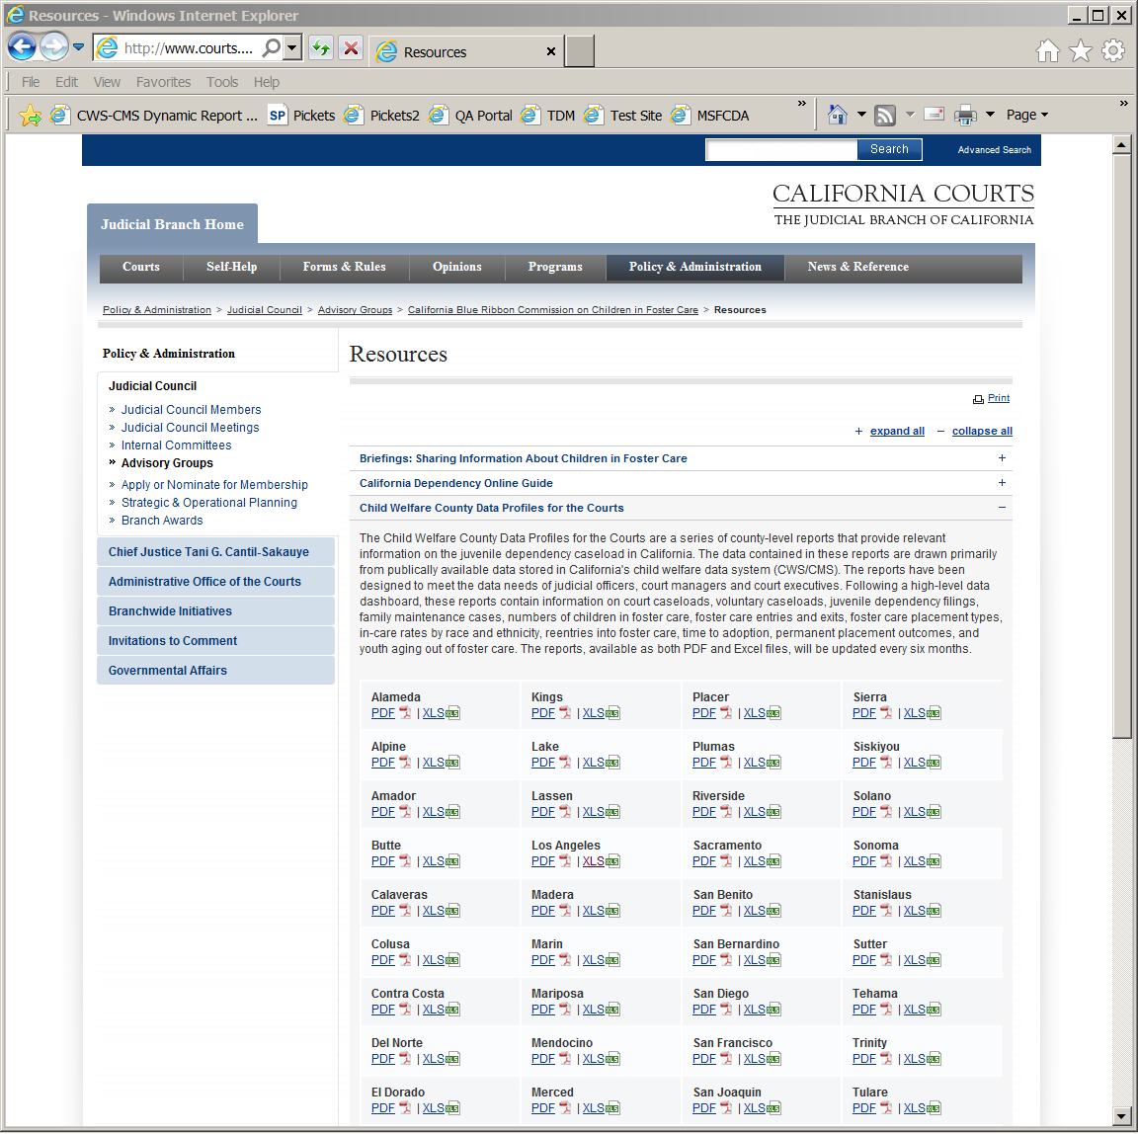
Online Demonstration

