Slide 1
A Prospective Analysis of POSTNEONATAL SIDS/SuID Following a Report of Maltreatment
Society for Social Work Research
San Diego, CA
Emily Putnam-Hornstein, PhD
Janet U. Schneiderman, PhD
Mario A. Cleves, PhD
Joseph Magruder, PhD
Barbara Needell, PhD
Henry F. Krous, MD

Slide 2
Acknowledgements
Thank you to our colleagues at the Center for Social Services Research and the California Department of Social Services
Data linkages funded by the H.F. Guggenheim Foundation
Support for this and other research arising from the California Performance Indicators Project generously provided by the California Department of Social Services, the Stuart Foundation, & Casey Family Programs

Slide 3
Background
Each year in the United States, more than 4,500 children die during the first 12 months of life with no immediately identifiable cause or explanation, deaths broadly defined as sudden and unexpected infant deaths (SUIDs)
Sudden Unexpected Infant Death
SIDS; R95
(50%)
ASSB; W75
(14%)
Undetermined; R99
(30%)
Other Determined Causes of Death
(~6%)
Notes:
Each year in the United States, more than 4,500 children die during the first 12 months of life with no immediately identifiable cause or explanation, deaths broadly defined as sudden and unexpected infant deaths (SUIDs).^{1,2} More than half of these SUIDs are ultimately classified as Sudden Infant Death Syndrome (SIDS),³ the designation for infant deaths that apparently occur during sleep and remain unexplained following a thorough autopsy, death scene investigation, and review of the medical history.^{4,5} Another 14% of these initially unexplained deaths are coded as accidental suffocation and strangulation in bed (ASSB) and approximately 30% are certified as deaths of undetermined cause.⁶

Slide 4
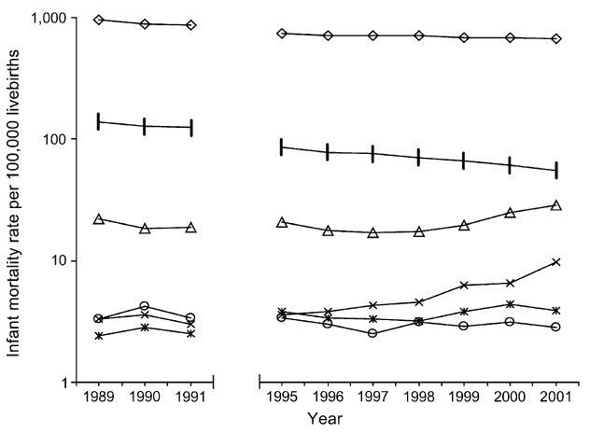
A Diagnostic Shift
The current distribution of SUID classifications reflects a diagnostic shift that has occurred over more than two decades, largely attributed to growing medical examiner and coroner adherence to 1991 definitional criteria for excluding all other causes of death before certifying a death as SIDS
postneonatal death rate
SIDS (R95)
Undetermined (R99)
ASSB (W75)
1. Shapiro-Mendoza CK, Tomashek KM, Anderson RN, Wingo J. Recent National Trends in Sudden, Unexpected Infant Deaths: More Evidence Supporting a Change in Classification or Reporting. American Journal of Epidemiology. 2006;163(8):762–769.
Notes:
The current distribution of SUID classifications reflects a diagnostic shift that has occurred over more than two decades, largely attributed to growing medical examiner and coroner adherence to 1991 definitional criteria for excluding all other causes of death before certifying a death as SIDS. ^{6,8–10} This shift is revealed by notably decreased rates of SIDS and correspondingly stark increases in the rates ASSB and deaths coded as undetermined in cause,^{4,7,9} and more subtle increases in deaths classified as abuse or neglect and other fatal injuries.^{10,11}
To further reduce SIDS incidence and prevent further increases in other causes of SUIDs, in 2005 the American Academy of Pediatrics expanded its policy on safe sleeping practices with specific recommendations for sleep surfaces, bedding, separate but proximate sleeping environments, and use of pacifiers.¹² Yet in 2009, the U.S. mortality rate for SIDS was nearly unchanged at 53.9 per 100,000 live births, and the rate of postneonatal death was also flat.¹³

Slide 5
Motivation
To further reduce SIDS/SUIDs, alternative public health campaigns and more targeted approaches may be required.
Prior contact with Child Protective Services (CPS) has been documented as a risk factor for preventable death. A similar relationship between CPS contact and sudden and unexpected infant deaths, however, has not emerged
This study builds upon earlier research, incorporating diagnostic shifts away from SIDS by examining those SUIDs additionally certified as undetermined and ASSB, and prospectively modeling the relative hazard of a sudden and unexpected infant death using linked birth, CPS, and death records.

Slide 6
Strength
risks
death
prospective
retrospective

Slide 7
linked dataset
infant cps records
209,481
LINKED DATA
birth no cps no death
birth records
1999-2006
birth cps no death
birth no cps death
birth cps death
infant death records
4.3 million
2,093
SUID
1,263
SIDS

Slide 8
Analysis
Competing Risk Survival Models
This modeling technique accounted for the fact that each infant was at risk of not only SIDS, ASSB, and deaths classified as undetermined, but also other postneonatal deaths
Observations were censored upon death or a child’s first birthday
First report to CPS entered as a time-varying covariate
DEATH (?)
CPS report
Risk factors associated with SIDS/SUIDS and being reported for maltreatment
Child A
Child B
28 days
365 days

Slide 9
variables
risk factor
Maltreatment Referral to CPS (including evaluated out)
confounders
outcome
Sex (male, female)
Birth Weight (<2500g, >=2500g)
Race/Ethnicity (White, Black, Latino, Native American, Asian/Pacific Islander)
Prenatal Care (1st Trimester, Late or No Care)
Any SUID (ICD-9 Codes: R95, R99, W75)
SIDS (R95)
ASSB (W75)
Undetermined (R99)
Maternal Age (<=19 years, 20+ years)
Paternity (established, missing)
Birth Coverage (public, private)
Notes:
Postneonatal deaths were classified using the International Classification of Diseases, 10th Revision (ICD-10).²³ SUIDs were stratified into three groups: (1) SIDS (code R95); (2) undetermined cause (code R99); and (3) ASSB (code W75).⁹ For each model, all other causes of death were coded as competing, censored events.
Independent Variable
We examined an earlier, non-fatal report of maltreatment as an independent predictor of a SUID. We included all reports of maltreatment: those screened out over the phone prior to an investigation, as well as those that were investigated and unfounded. This decision is consistent with a growing body of research indicating the report of maltreatment as the relevant marker of a child’s risk, rather than the subsequent handling and disposition of that report.^{14,24–26} Prior CPS contact was entered into our models as a time-varying covariate based on the date the maltreatment report was received. As such, children fell in the full population of children born and at risk of death until the date they were first reported to CPS, at which point they were re-classified as a child with a prior report of maltreatment.
Available data prevented an examination of established SUID/SIDS risk factors specific to the sleep environment,²⁷ but did allow for adjustments to other risk factors including child demographics, child development, and family/maternal characteristics. Higher rates of SIDS deaths have been observed among infants who are male and African American.^{8,28–30} Developmental risk factors include low birth weight and an infant age of 2-4 months.^{1,29,31,32} Family/maternal risk factors for SIDS include young maternal age, single motherhood, late or no prenatal care, and low socio-economic status.^{1,29,30} Given well-documented variations in SIDS risk, adjustments were made for seven covariates available on the birth record: (1) child’s sex (male vs. female); (2) maternal race/ethnicity (Black, Latino, Asian/Pacific Islander, or Native American vs. White); (3) birth weight (<2500 grams vs. <=2500 grams); (4) prenatal care (first trimester care vs. late or no care); (5) birth payment method (public insurance vs. private insurance); (6) maternal age (teen mother vs. mother age 20+); and (7) paternity establishment (missing vs. established). Our time to event modeling approach additionally adjusted for child’s age and therefore developmental stage.

Slide 10
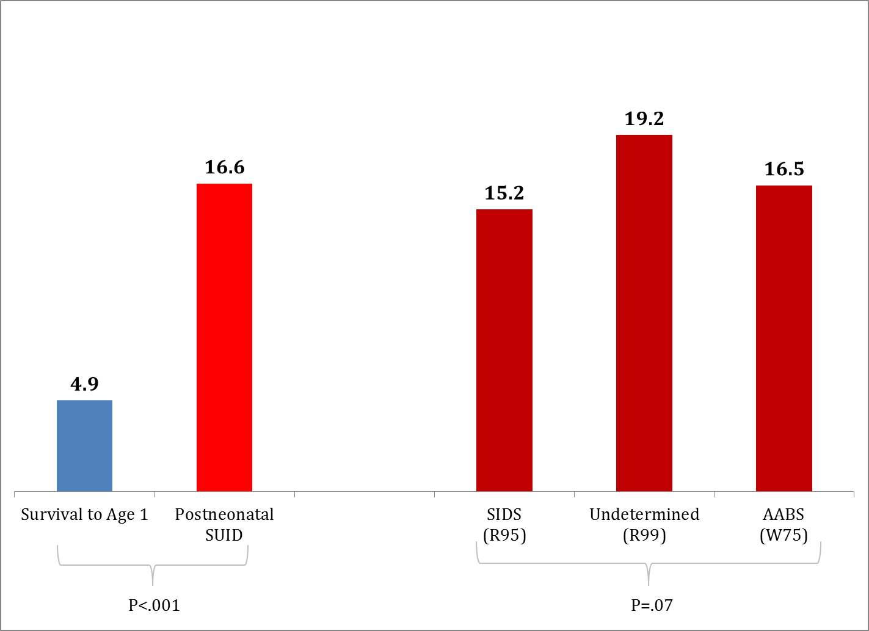
Prior Maltreatment Reports

Slide 11
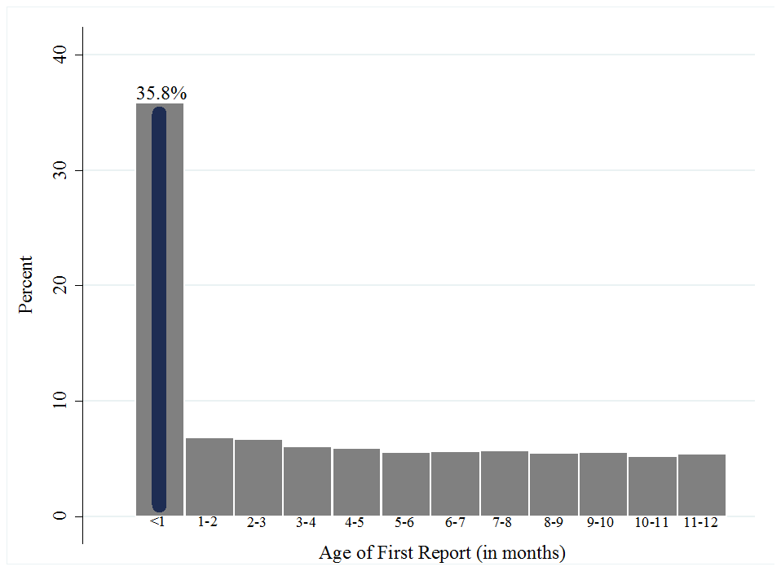
distribution of first reported maltreatment among infants born in California between 1999-2006 and reported for abuse or neglect before age 1

Slide 12
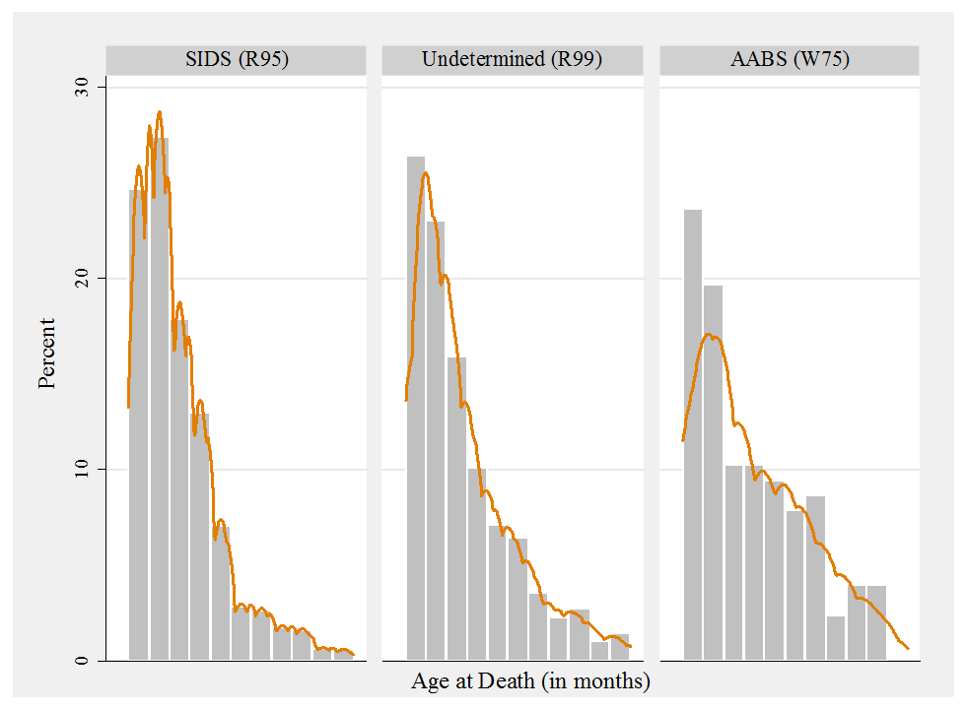
Age distribution of postneonatal SUIDs among infants born in California between 1999-2006

Slide 13
Adjusted Competing Risk Models
 | SUIDS (R95, R99, W75) vs. Survival |  | SIDS (R95) vs. Survival |  | Undetermined (R99) vs. Survival |  | ASSB (W75) vs. Survival
 | HR | 95% CI | HR | 95% CI | HR | 95% CI | HR | 95% CI
Prior CPS Referral | 3.49*** | (3.02, 4.02) | 3.22*** | (2.66, 3.89) | 4.21*** | (3.32, 5.33) | 2.30*** | (1.21, 4.36)
No Referral | Ref. | --- | Ref. | --- | Ref. | --- | Ref. | ---
Notes. *** P<.001; Models adjusted for child sex, race/ethnicity, birth weight, prenatal care, insurance type, maternal age, paternity establishment.

Slide 14
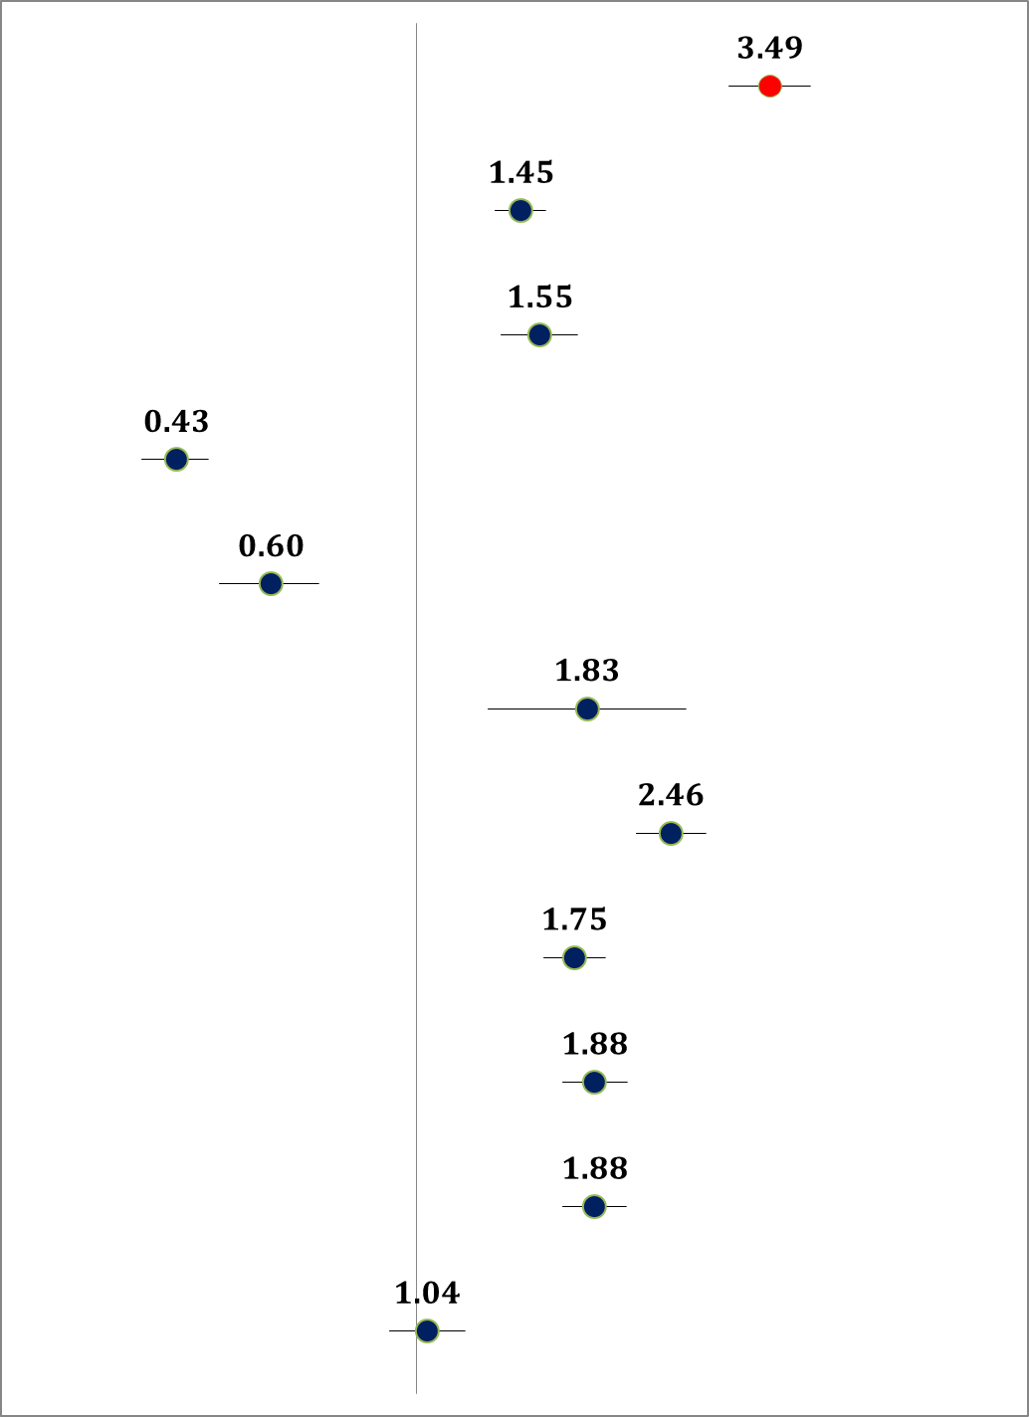
Prior CPS Referral (vs. none)
Male (vs. female)
Black (vs. White)
Latino (vs. White)
Asian/PI (vs. White)
Native American (vs. White)
Birth Weight <2500g (vs. >=2500g)
Late/Absent Prenatal Care (vs. 1st Trimester)
Maternal Age <=19 (vs. 20+ years)
Public Insurance (vs. private insurance)
Missing Paternity (vs. Established)

Slide 15
(three possible) Interpretations
Prior Report to CPS as a Predictor of SUID
1. Infants reported to CPS have unique risks associated with SUIDs that account for the relationship observed (e.g., prenatal alcohol or drug exposure)
2. Infants reported to CPS reflect a very high-risk subset of infants born into families in which there remains a partial or lagged penetration of public health safe sleeping guidelines
3. A continued inability to unequivocally differentiate SIDS from infant deaths caused by soft suffocation, whether accidental or inflicted
Notes:
Unmeasured risks
A partial or lagged penetration of public health campaigns
Families of infants reported to CPS have a concentration of both chronic and acute stressors that may reduce adherence to safe sleeping guidelines
a potentially significant share of deaths classified as SIDS, ASSB, and undetermined are missed maltreatment fatalities

Slide 16
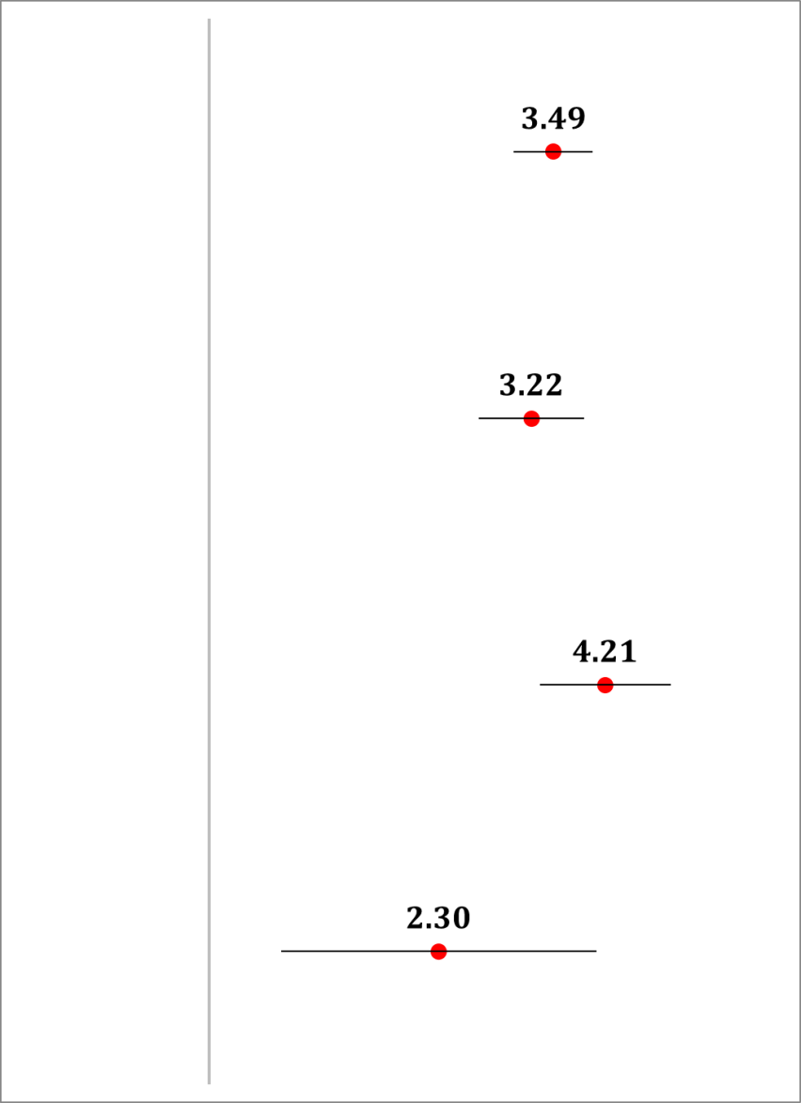
Summary
Although prior studies have explored reports of maltreatment as possible antecedents of SIDS, this is the first study in which a prior allegation of abuse or neglect was identified as a prospective risk factor for SIDS and other postneonatal SUIDs
An infant’s earlier, non-fatal referral to CPS was the single strongest predictor of SIDS, ASSB, and a death of undetermined intent
SUID
SIDS
undetermined
ASSB

Slide 17
Limitations
Maltreatment referral rates vary widely across states, reflecting different definitions of abuse and neglect, varying community thresholds for reporting an infant to CPS, and capturing diverse populations of at-risk populations of infants.
CPS contact as a prospective risk marker for SUIDs may vary with the risk profile of reported infants.
No ability to adjust for maternal smoking – one of the most well-established markers of SUIDs
No information concerning prenatal alcohol consumption or illegal drug use
No ability to adjust for the sleep environment/adherence to safe sleeping practices
Notes:
Limitations:
Maltreatment referral rates vary widely across states, reflecting different definitions of abuse and neglect, varying community thresholds for reporting an infant to CPS, and capturing diverse populations of at-risk populations of infants. As such, CPS contact as a prospective risk marker for SUIDs may vary with the risk profile of reported infants

Slide 18
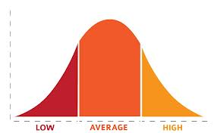
Conclusions
Data from the past decade suggest there may be a ceiling to the influence and reach of SIDS awareness and prevention campaigns.
If this is the case, efforts to further reduce postneonatal infant deaths will require more intensive interventions targeted to populations with a greater concentration of risk factors.
Infants reported to CPS represent a very vulnerable subset of children...

Slide 19
Questions? ehornste@usc.edu

