Slide 1
Relative permanence:
Society for Social Work
& Research
New Orleans
1/14/2017
Reentry for Children Discharged to
Subsidized Legal Guardianship with Kinship Caregivers
Joseph Magruder, PhD
University of California, Berkeley
Daniel Webster, PhD
University of California, Berkeley
Andrea Lane-Eastman, MA
University of Southern California
Arno Parolini, PhD
University of Melbourne
Aron Shlonsky, PhD
University of Melbourne

Slide 2
Background
Relative placements, past findings:
More stable
Reunification slower
Reentry less likely for those who reunify
Achieving permanency is more difficult - relatives (and social workers) have resisted adoption by kin
California extended guardian assistance payments (Kin-GAP) to relatives who were foster parents in 2000.
Ongoing analysis to examine the impact of relative guardian exits on achieving permanency and the longevity of this type of discharge.
How likely do these children return to care, and what characteristics are associated with disrupted guardianships?

Slide 3
Data & Method
California Children’s Services Archive Data System
Exits from Jan. 1, 2001 to Dec. 31, 2010 were included.
Event history analysis of reentry following exit to relative guardianship:
Children were followed from discharge to reentry* to care (or study end date—October 1, 2016)
Stratified Cox regression
Cox regression with time-dependent variables
*Does not include “positive” reentries that ended with adoption or guardianship with same caregiver as original guardian.

Slide 4
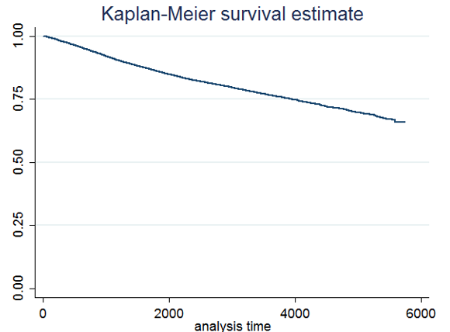
Reentry over time (in days) following discharge to
relative guardianship
Notes:
25,596 total children exited to relative guardianship from 2001 to 2010. 4,620 (18%) had returned to care by the study cut off date.
Percent reentering within 12 months (~3%) and 24 months (~6%) were much less than reentry rates found in past analyses for similar follow up times for children exiting to reunification (C1.4: 12mo≈12%; 24mo≈17%), or other forms of guardianship. Past analyses also indicated that exits to relative guardianships had lower rates of recurrence at 12 months.

Slide 5
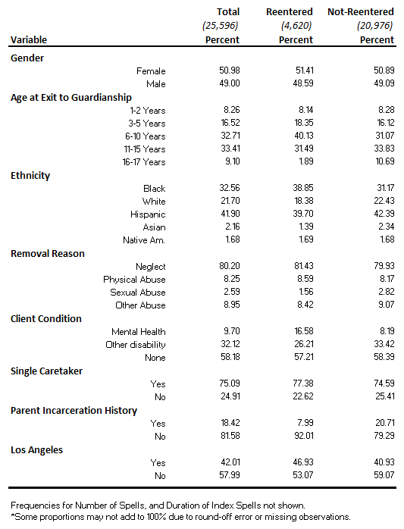
Frequencies and Proportions (N = 25,596)
Children Exiting to Relative Guardianship 2001-2010 (Table 1)

Slide 6
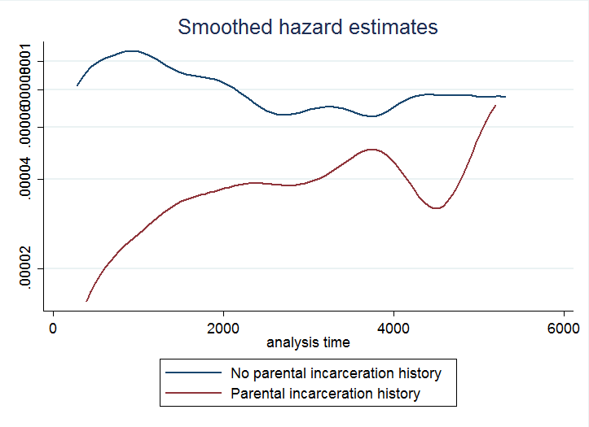
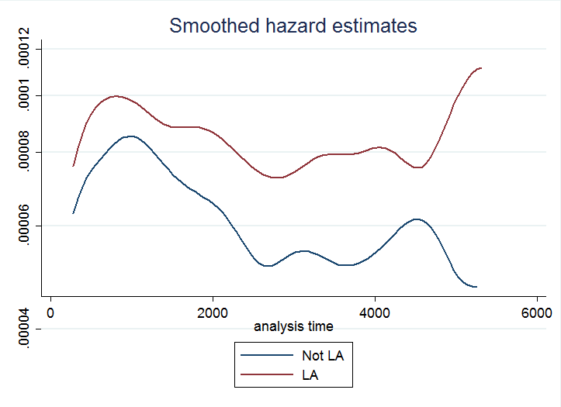
Cox Models on Time to Reentry Following Exit to Relative Guardianship
Model 1: Stratified Cox Regression (not shown)
Replicated effects observed in prior analyses (e.g., higher reentry likelihood for females, Blacks, Hispanics, neglect removal reason; lower reentry for parent incarceration history).
Checked model specification: fit was good, however proportional hazards assumption did not hold – e.g., time-varying effects for parent incarceration history, Los Angeles.
Notes:
Prior analyses presented previously also found: females, black and Hispanic children, and some form of client condition to increase likelihood or reentry; and parent incarceration history decreased likelihood of reentry
Proportional hazards assumption assessed using test based on Schoenfeld residuals, and generalized by Grambsch and Therneau.

Slide 7
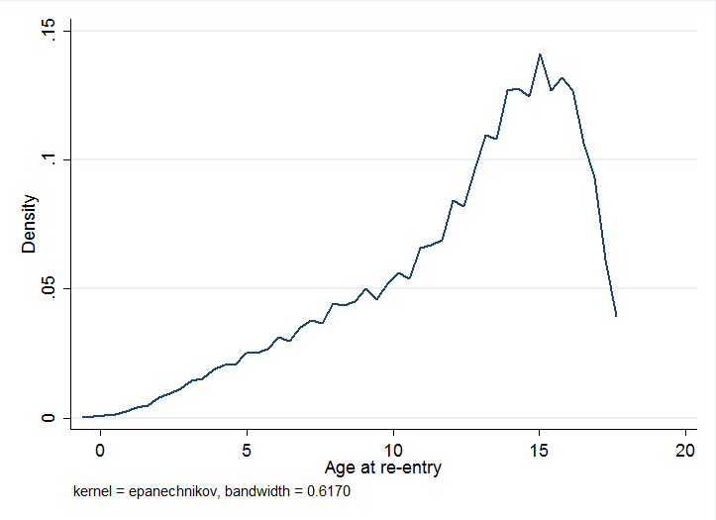
Cox Models on Time to Reentry Following Exit to Relative Guardianship
Also, data indicated high number of children reentering between the ages of 11 and 15.
Further analysis sought to examine issue of whether reentry is correlated with child development (e.g., ‘teen onset’ effect).
Notes:
Prior analyses presented previously also found: black and Hispanic children, and some form of client condition to increase likelihood or reentry; and parent incarceration history decreased likelihood of reentry

Slide 8
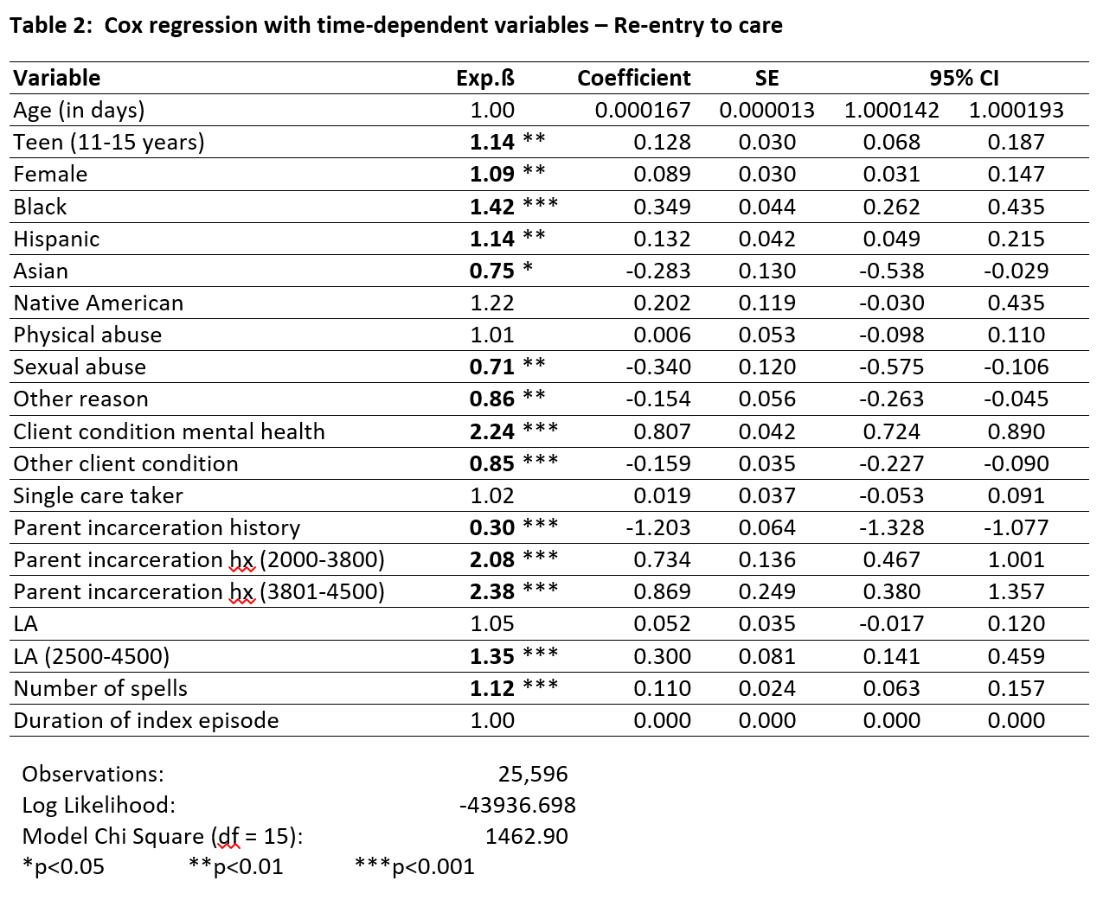
Cox Models on Time to Reentry Following Exit to Relative Guardianship (Table 2)
Notes:
Models were fit adding an indicator for t > 4500 for both, LA and parent incarceration. However the coefficients were insignificant and they were therefore dropped from the model.

Slide 9
Results
Model 2: Cox Regression with Time-Dependent Covariates
Model fit the data reasonably well.
Effects very similar to the stratified Cox regression-- however, time-dependent indicators highly significant.
Teen effect looks negligible, but is not. It can only be considered with the Age overall variable (similar to an interaction).
A child entering teen years (age 11 – 15) could only be compared with a child not entering the teen years.
Applying coefficients, for example, after one year of discharge to relative guardianship—a child entering teen years would have about a 14% greater risk of re-entry than a non-teen.
Notes:
Model fit well based on the cumulative hazard of the Cox-Snell residuals.

Slide 10
Results
Continued…
Model 2: Cox Regression with Time-Dependent Covariates
Child mental health condition identified prior to discharge had more than twice the hazard of reentry, while ‘other’ identified disability (e.g., physical, alcohol, drugs) had decreased reentry risk.
Parental incarceration history initially decreased reentry risk; but over time this factor more than doubled risk of reentry (HR > 2.0).
LA factor was non-significant, while the interaction with the indicator variable for longer time in LA (t >2500 & t ≤ 4500) was highly significant (HR: 1.35).
Notes:
Model fit well based on the cumulative hazard of the Cox-Snell residuals.

Slide 11
discussion
Child development may be correlated with re-entry to care--there could be unmet service needs for relative guardians of children transitioning into adolescence.
Client disability factor could indicate caregivers better able to cope with, and/or access post-permanency services for some conditions (physical disability) and not others (mental health).
Incarceration history factor could potentially indicate destabilizing influence of parents released from corrections (but additional data would be needed to examine this factor).
Risk of reentry for children in LA increases notably after about 7 years (2500 days) post-discharge could potentially be artifact of overrepresentation of large group of children (some perhaps not ideally suited for the program) discharged in the initial years.

Slide 12
Next steps
Models still a work in development.
Adjust age group categories in additional models to better understand the impact of this factor.
Apply modeling approach to account for interaction effects.
Number of observations will permit model building on sub-sample, with subsequent application to the rest of the data set.
Notes:
Models are still work in development: Especially the time-dependent effects may be coarse at this point. However the effects appear to be reasonable and in line with the nonparametric results. A preliminary discrete time model was also fit on annual time intervals. The results were very similar, increasing confidence in the findings presented here.
To account for interaction effects will apply a non-parametric approach which assumes no functional forms: conditional inference trees, a recursive partitioning algorithm.

Slide 13
Questions? joemagruder@berkeley.edu dwebster@berkeley.edu lanea@usc.edu arno.parolini@unimelb.edu.au aron.shlonsky@unimelb.edu.au
The California Child Welfare Indicators Project is supported by
the California Department of Social Services,
the Conrad N. Hilton Foundation, and the Stuart Foundation

