Slide 1
A Population-Level Examination of Non-Fatal & Fatal Maltreatment in California:
What are the risks and what can we do?
Emily Putnam-Hornstein, MSW, PhD
Center for Social Services Research
School of Social Welfare
University of California, Berkeley

Slide 2
acknowledgements
thank you to my colleagues at the Center for Social Services Research and the California Department of Social Services
support for this research provided by
  The Harry Frank Guggenheim Foundation
  The Fahs-Beck Foundation
  The Center for Child and Youth Policy
ongoing support for research arising from the California Performance Indicators Project is generously provided by CDSS and the Stuart Foundation

Slide 3
background
Center for Social Services Research (CSSR)
  California Performance Indicators Project
    longstanding university/agency partnership
    longitudinal configuration of state’s child protective services data
    technical assistance to California counties & state
    consultation services to other state child welfare agencies
    publicly available website for tracking outcomes and performance indicators (interactive queries)

Slide 4
overview
“big picture” trends in child abuse and neglect from the last decade
  what we know…and what we don’t
adopting a public health approach to reducing child maltreatment
  the history of history
  maltreatment surveillance in California
targeting services and identifying risk factors from birth data
understanding the risks faced by maltreated children from death data

Slide 5
“big picture” trends
(a few things we know)

Slide 6
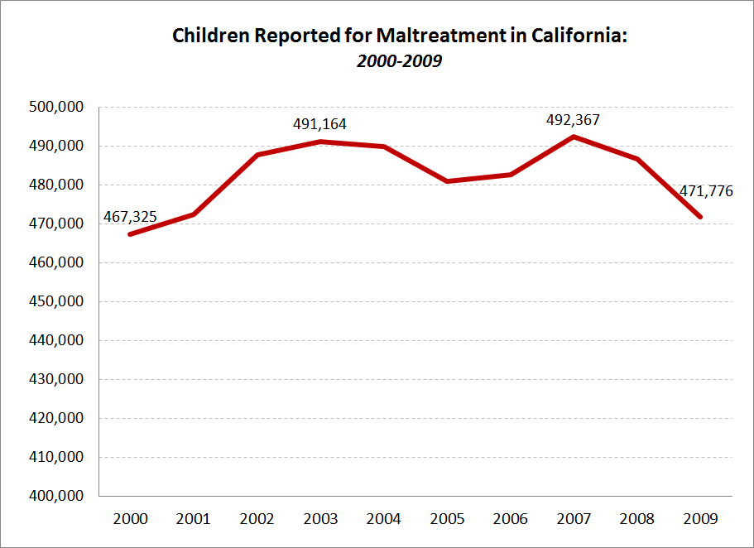

Slide 7
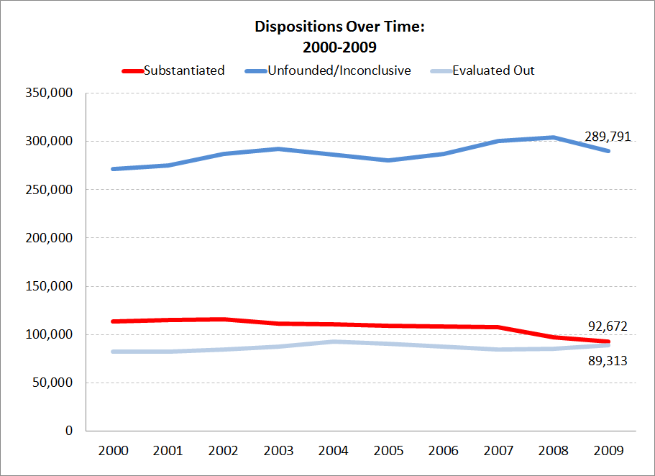

Slide 8
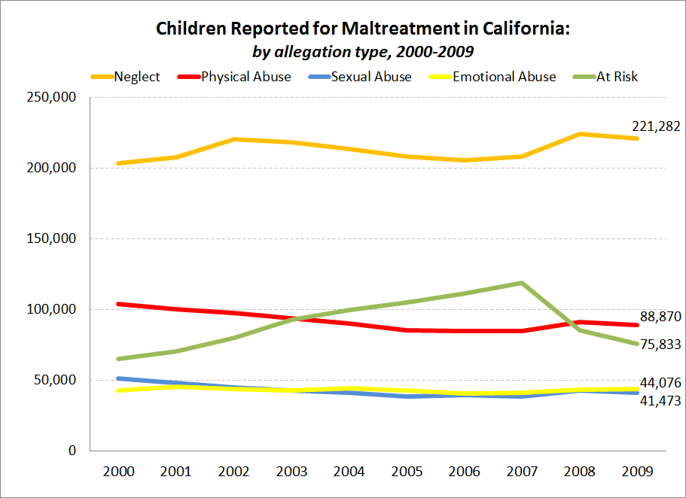

Slide 9
limitations of CPS data
(what we don’t know)

Slide 10

the iceberg analogy
Maltreated children known to child protective services
Maltreated children not known to child protective services

Slide 11
a “snapshot” of victims
before
CPS Data
after
Children not Reported for Maltreatment

Slide 12
a bit about a public health approach

Slide 13
public health
historically, public health efforts were focused on the study and prevention of disease transmission
the application of the public health disease model to injuries occurred only in the latter half of the 20th century, driven by shifts in public health burdens from disease to injury
public health efforts, however, were focused on the reduction of unintentional injuries
disease transmission
injury prevention

Slide 14
the incorporation of child maltreatment
from unintentional childhood injuries…
  “if some infectious disease came along that affected children [in the proportion that injuries do], there would be a huge public outcry and we would be told to spare no expense to find a cure and to be quick about it.” Surgeon General C. Everett Koop, 1989
to child maltreatment
  “I can think of no terror that could be more devastating than child maltreatment, violence, abuse, and neglect perpetrated by one human being upon another…I believe it is time for critical thinking to formulate a new national public health priority, preventing child maltreatment and promoting child well treatment.” Surgeon General Richard H. Carmona, 2005

Slide 15
child maltreatment as a public health problem
a “successive redefining of the unacceptable”
  physical abuse = physical injury
  neglect
    William Haddon Jr. recognized that “frostbite is a type of injury…caused by the absence of a necessary factor, the ambient heat needed for normal health.”
    analogously, children may suffer harm resulting from an absence of parental nurture, care and supervision
  emotional maltreatment
    “Not all injuries that result from child maltreatment are visible. Abuse and neglect can have lasting emotional impact as well.” (Centers for Disease Control and Prevention)

Slide 16
a public health approach to child maltreatment
the systematic collection, analysis, interpretation, and dissemination of data regarding child abuse and neglect for use in public efforts to reduce the incidence of maltreatment and improve child health
widespread implementation and dissemination of comprehensive evidence-based, maltreatment-prevention programs
the development and testing of maltreatment prevention strategies, with primary, secondary, and tertiary efforts targeted to different segments of the population
the identification of child, family, and environmental factors that both place children at risk of maltreatment, and protect them
(REPEAT.)

Slide 17
strengths of a public health approach
a growing-body of scientific evidence suggesting that preventing child maltreatment is an effective strategy for promoting health and reducing disease later in life
a large health infrastructure with a record of reducing harm to children through education, policy, and intervention programs focused on both the environment (e.g., safety tops) and behavior modifications (e.g., use of bike helmets, anti-smoking campaigns)
potential for greater political/public support will if neglect and abuse are framed in terms of child health, rather than family dysfunction
CPS agencies are crucial to ensuring the well-being of children, but do not have the resources to address broader social and economic causes of child maltreatment or to navigate widespread prevention-focused efforts

Slide 18
a public health model in California

Slide 19
expanded surveillance of child victims
child protective service records
birth data
death data
before
CPS Data
after
Children not Reported for Maltreatment
population-based information

Slide 20

record linkages 101
File A
File B
SSN
SSN
deterministic match
First Name
First Name
Middle Name
Middle Initial
Last Name
Last Name
probabilistic match
Date of Birth
Date of Birth
Address
Zip Code

Slide 21
linked dataset
cps records
514,000
LINKED DATA
birth no cps no death
birth records
birth cps no death
birth no cps death
birth cps death
4.3 million
25,000
all deaths
death records
1,900
injury deaths

Slide 22
what have we done with these data?

Slide 23
identification of risk factors
family
pregnancy
child
?
Maltreatment
Referral
Substantiation
Entry to Care
?
over 40% of children re-reported w/in 2 years, independent of prior disposition (Needell, et al., 2010)
fallibility of correctly ascertaining maltreatment (Drake, 1996, Drake et al., 2003)
lack of distinguishable differences in subsequent behavioral measures (Hussey et al., 2005, Leiter, Myers, & Zingraff, 1994)

Slide 24
birth record variables
maternal age
<=19
maternal education
<high school
pregnancy termination hx
prior termination
20-24
high school
named father
none reported
missing
named father
# of children in the family
one
two
birth payment method
public/med-cal
other
25-29
30+
some college
college+
three+
sex
female
birth weight
2500g+
prenatal care
1st trimester
<2500g
birth abnormality
3rd trimester
no care
present
none
maternal birth place
US born
non-US born
race
native american
black
Hispanic
white
asian/pacific islander
2nd trimester
male

Slide 25
and what have we learned?

Slide 26
selected findings…
14% of children in birth cohort were reported to CPS by age 5
  lower bound estimate…could not match 16% of CPS records
  25% of these children were reported within the first 3 days of life
  35% of all reported children were reported as infants
11 of 12 variables were significantly associated with CPS contact
  crude risk ratios >2 were observed for 7 variables
Contact with CPS is hardly a rare event for certain groups
  30% of black children reported
  25% of children born to teen mothers

Slide 31
what can we do with these data?
(can we predict maltreatment? the envelope please…)

Slide 32
an epidemiologic risk assessment tool?
we classified as “high risk” any child with three or more of the following (theoretically modifiable) risk factors at birth:
    late prenatal care (after the first trimester)
    missing father information
    <=high school degree
    3+ children in the family
    maternal age <=24 years
    Medi-Cal birth for a US-born mother

Slide 33
administered at birth?
Full Birth Cohort
Children Reported to CPS

Slide 34
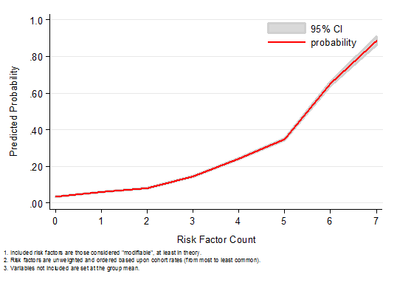
recognizing the risk associated with the presence of multiple risk factors…
High Risk on Every Modifiable Risk Factor: 89% probability of CPS report
Low Risk on Every Modifiable Risk Factor: 3% probability of CPS report

Slide 35
summary
data collected at birth can be used to identify those children in a given birth cohort who are at greatest risk of future CPS contact
compared with the demographics of the birth cohort as a whole, these young children are defined by the presence of multiple risk factors
against an invariable backdrop of limited resources, the ability to provide prevention/intervention services to a highly targeted swath of at-risk families has the potential for cost-savings to be realized, while also improving child well-being

Slide 36
discussion
could we use universally collected birth record data to target children and families for services at birth?
  A standardized assessment tool can never replace more comprehensive assessments of a family’s strengths and risks
  But against an invariable backdrop of limited resources, the ability to prioritize investigations and adjust levels of case monitoring in order to meet the greater needs of a targeted swath of at-risk children and families has the potential for cost-savings to be realized, while also improving child well-being and reducing the incidence of child deaths

Slide 37
what about death records?

Slide 38
child maltreatment fatalities
the ultimate preventable tragedy…and particularly heartbreaking when the family is already known to CPS
response?
maltreatment report
child dies
public outcry
public hearings
child welfare director ousted
agency redesign

Slide 39
child death review teams (CDRTs)
first established in LA in 1978, now in place in almost every state and in most counties in California
  “The primary mission of the State Child Death Review Council is to reduce child deaths associated with child abuse and neglect. The secondary mission is to reduce other preventable child deaths.” (CA Child Death Review Council, 2005)
  most California CDRTs review all sudden, traumatic and/or unexpected child deaths (i.e., Coroner cases), including injury, natural and undetermined deaths (selection criteria vary by team, budgets)

Slide 40
missing epidemiological context
CDRTs compile data to identify child death patterns and clusters, examine possibly flawed decisions made by CPS and other systems, summarize the characteristics of fatally injured children, and make policy and practice recommendations
  yet these recommendations are based on information concerning only those children who have already experienced the outcome of interest (death)
  absent is information concerning the experiences and characteristics of deceased children who were similarly reported to CPS, but did not die

Slide 41
how have we analyzed death records?

Slide 42
analysis of linked death records
focused on injury deaths, considered almost entirely preventable among this youngest group of children, provides a ‘culture-free’ measure of child well-being
  unintentional (all mechanisms)
  intentional (all mechanisms)
looked at all children reported for maltreatment (including those evaluated out over the phone)
  by allegation type
  by disposition
  by placement in foster care
made adjustments for sociodemographic risk factors present at birth

Slide 43
descriptive findings

Slide 44
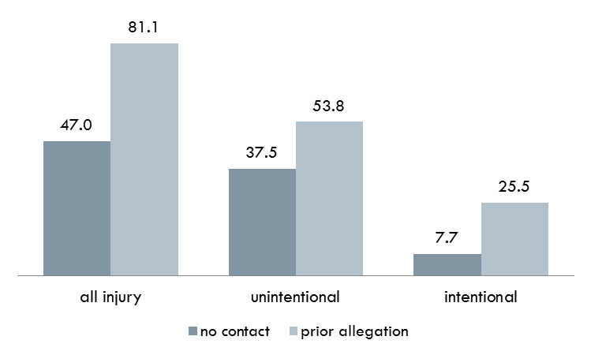
Cumulative rates of injury death by age 5, per 100,000

Slide 45
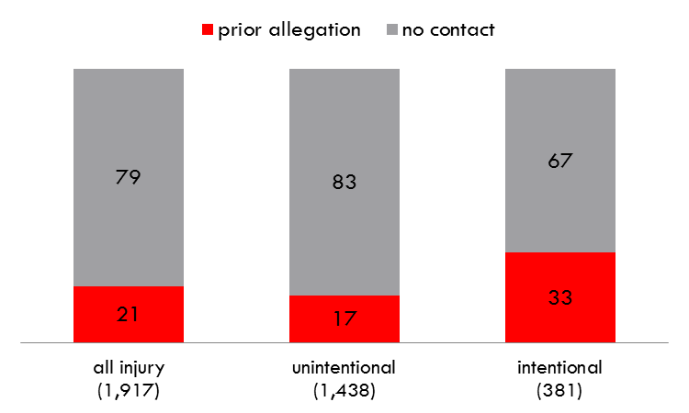
prior non-fatal cps contact among fatally injured children
Notes:
prior non-fatal cps contact …
20.7% (396/1917) of all fatal injuries
17.3% (248/1438) of all unintentional injury fatalities
33.1% (126/381) of all intentional injury fatalities
+ 591 reported after the fact

Slide 46
Question 1:
Do children who were previously reported for maltreatment face a greater risk of preventable injury death?

Slide 47
Answer 1
Yes.
after adjusting for other risk factors at birth, a prior report to CPS emerged as the strongest predictor of injury death during a child’s first five years of life
a prior report to CPS was significantly associated with a child’s risk of both unintentional, and intentional, injury death

Slide 48
adjusted rate of injury death for children with a prior allegation of maltreatment, by cause of death
HR: 2.59
HR: 2.00
HR: 5.86

Slide 49
discussion
these data indicate that a report to CPS is not a random event
  it reflects more than just poverty
  a report captures/signals unmeasured family dysfunction, child risk
a number of easily measured demographic variables demonstrated strong and independent associations with injury death risk
  opportunities for hotline screening tools to be adjusted and for subsequent practice protocols to be further tailored to the risk of individual clients ?

Slide 50
Question 2:
If a report of maltreatment is “evaluated out” over the telephone, was the child at no greater risk of injury death than other sociodemographically similar children?

Slide 51
Answer 2
  No.
  these data indicate that children whose allegations were “evaluated out” were fatally injured at 2.5 times the rate of unreported children (adjusted)
  children who were evaluated out died at rates equivalent to investigated children with an unfounded/inconclusive allegation

Slide 52
adjusted rate of injury death for children who were “evaluated out”
HR: 2.49
HR: 2.45
HR: 2.47

Slide 53
discussion
no evidence that we are able to effectively screen maltreatment allegations over the phone, without an in-person investigation
  in-person investigation of all reports involving children < age 5?
  possibly cost-effective, given that 40% of children are re-reported within 2-years, regardless of initial disposition?

Slide 54
Question 3:
Does placement in foster care (for one day or more) reduce a child’s risk of injury death?

Slide 55
Answer 3
Yes.
placement in foster care was protective
  adjusted, no placement in foster care: 3.40*** [2.87, 4.03]
    unintentional: 2.12*** (1.69, 2.65)
    intentional: 10.38*** (7.55, 14.27)
  adjusted, 1+ day placement in foster care: 1.38 [0.87, 2.19]
    unintentional: 1.00 (0.55, 1.84)
    intentional: 3.45** (1.57, 7.57)

Slide 56
discussion
implicit when a placement occurs is that the risks associated with keeping the child at home were deemed to outweigh the uncertainty that the child needed protection
unfortunately, errors in which a child is harmed following a decision to not place in foster care are more tangibly measured (e.g., injury or death) than the longer-term effects that may accompany an unneeded removal
how we weigh the trade-offs in foster care placement amounts to a value-laden policy question…thoughts?

Slide 57
Question 4:
Does a child’s risk of injury death vary by maltreatment allegation type?

Slide 58
Answer 4
Yes.
children with a prior allegation of physical abuse were found to have intentional injury death rates that were dramatically higher than unreported children and children reported for neglect
rates of unintentional injury death were statistically indistinguishable across allegation types

Slide 59
adjusted rate of injury death for children with a prior physical abuse allegation
HR: 7.39
HR: 1.81
HR: 38.49

Slide 60
discussion
the heightened rate of death associated with a physical abuse allegation has been little discussed, despite its suggestion in other data sources (e.g., NCANDS)
use of a physical abuse allegation involving a young child as a method for strategically tailoring the level of service and monitoring that follow?
these children represent only a small fraction of all children reported to CPS, providing an easy group to target (12%)…

Slide 61
Questions?
eputnamhornstein@berkeley.edu
510.643-4358 (w)
917.282.7861 (c)

